Slide 1
Presentation of Analysis of Customer Retention Project
Presented by:
Amit Matreja
Data Science Intern
Fliprobo Technologies

Slide 2
Problem Analysis
Customer satisfaction has emerged as one of the most important factors that guarantee the success of online store; it has been posited as a key stimulant of purchase, repurchase intentions and customer loyalty.
A comprehensive review of the literature, theories and models have been carried out to propose the models for customer activation and customer retention.
Five major factors that contributed to the success of an e-commerce store have been identified as: service quality, system quality, information quality, trust and net benefit.
The research furthermore investigated the factors that influence the online customers repeat purchase intention. The combination of both utilitarian value and hedonistic values are needed to affect the repeat purchase intention (loyalty) positively. The data is collected from the Indian online shoppers. Results indicate the e-retail success factors, which are very much critical for customer satisfaction.

Slide 3
Concept
Customer Retention refers to the ability of a company to retain its Customers over some specified period.
High Customer retention refers to That most count of Customers return to buy the product or services.
A company’s ability to attract and retain old and new Customers is related not only to its product or services but also the way it services or delivers its customers.

Slide 4
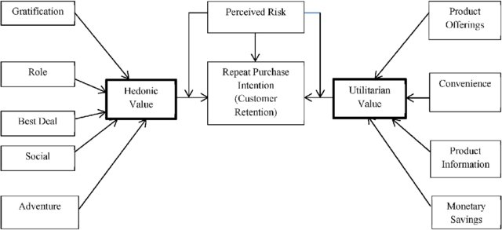
Visual Representation of Customer Retention
Here we can Observe that the Customer retention is based on 3 Main factors,i.e.
Hedonic Value
Utilitarian Value
Perceived Risk

Slide 5
Software and Libraries Used in Analysis:
Softwares
Python 3.0
Jupyter Notebook
Libraries:
Pandas
Numpy
Matplotlib
Seaborn

Slide 6

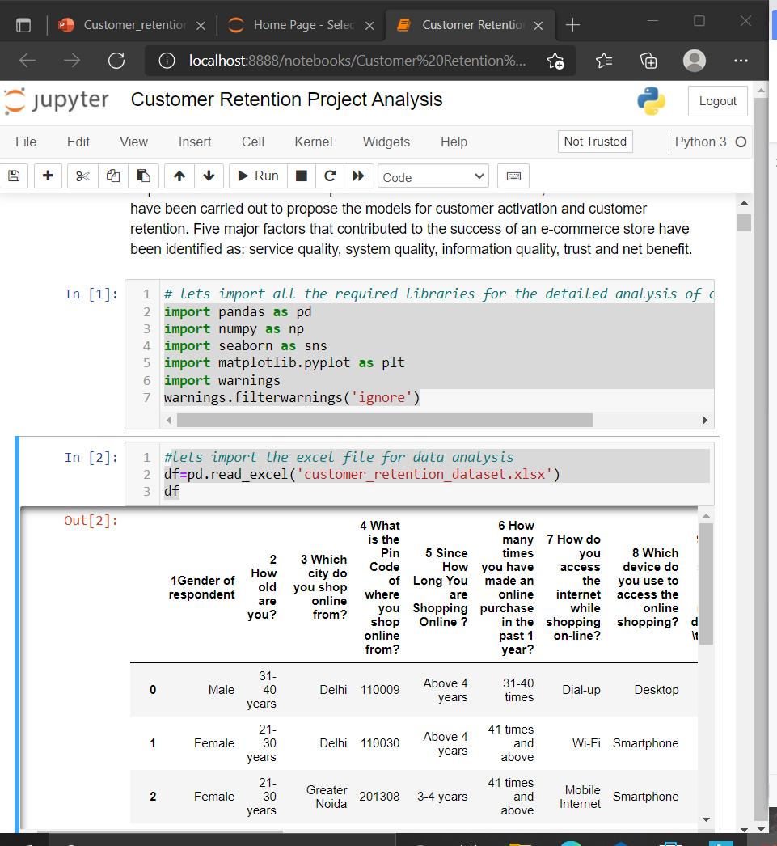
Starting with importing the data
First, we imported the dataset Customer_retention_dataset provided by Fliprobo Technologies. The file was in Excel format.
The Dataset contains 269 rows and 71 columns.
We begin with importing, loading and reading the dataset fromimport pandas as pd
the xlsx file using the read_excel() function.

Slide 7
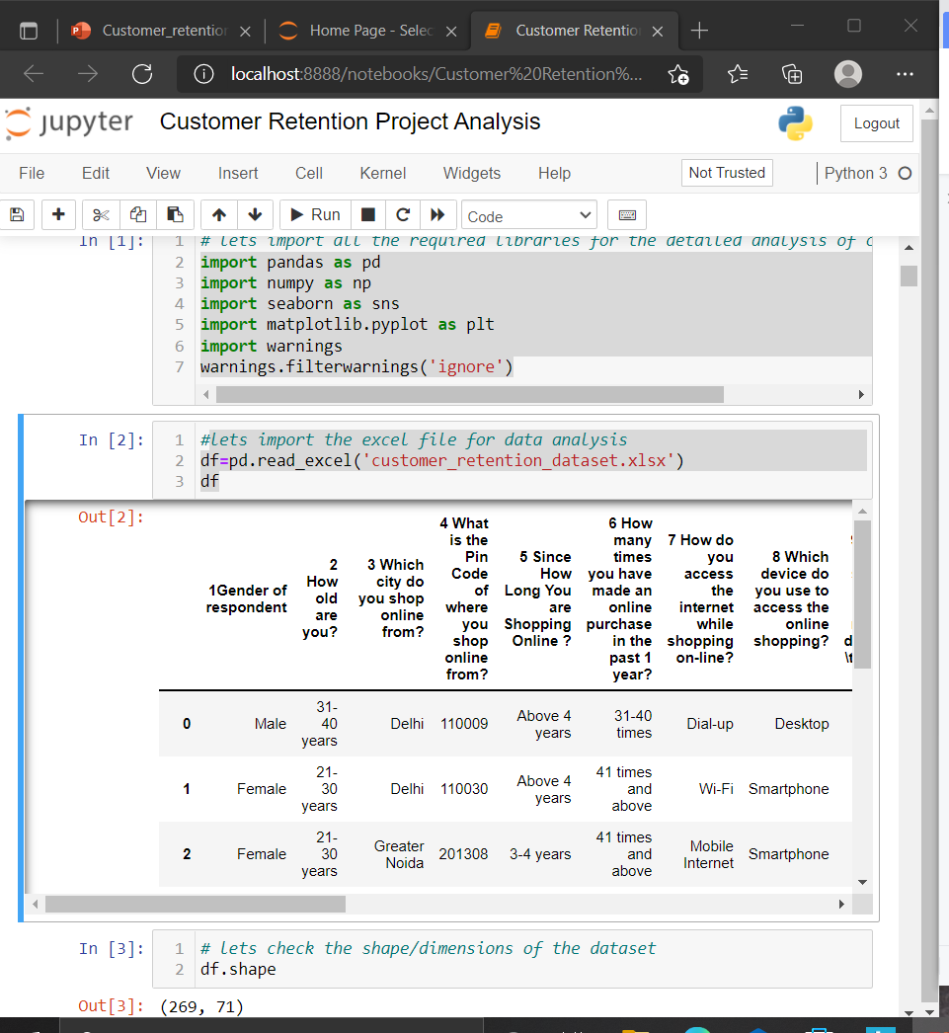
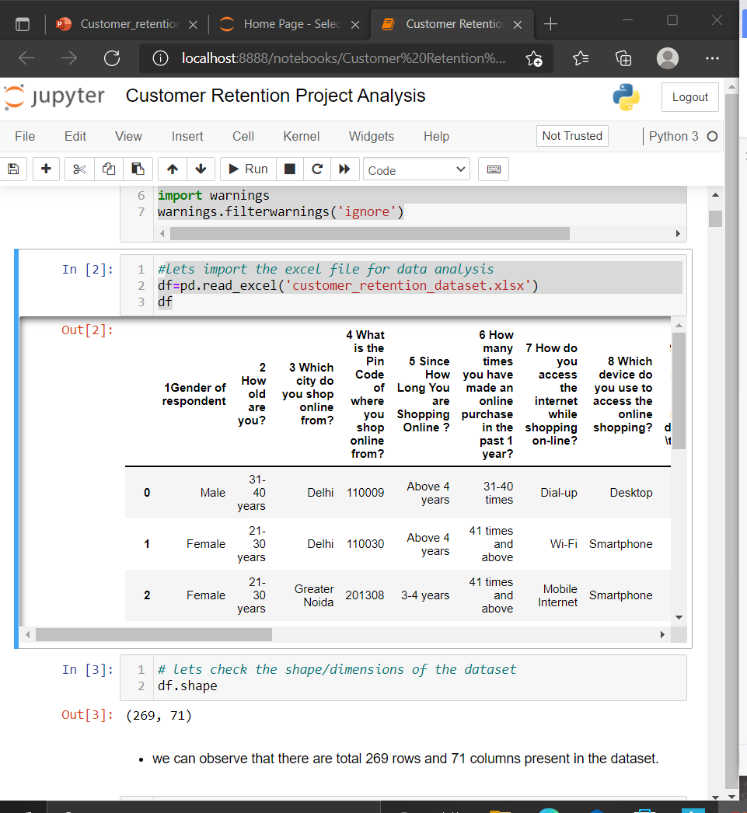
DataSource
Here we can see that there are 269 Rows and 71 Columns present in the dataset.

Slide 8
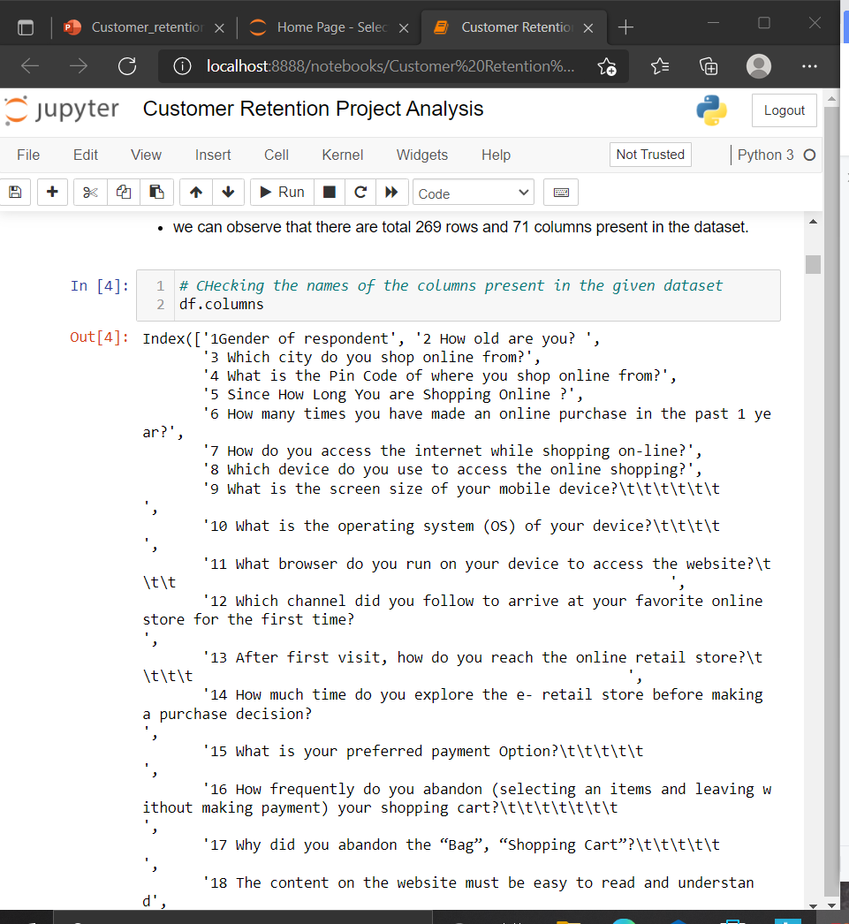
Checking the Names of Columns
Here we can see names of all the columns present in the dataset. And we can notice that there are 2 columns 3 Which city do you shop online from? and 4 What is the Pin Code of where you shop online from? has the same relevance so, we can drop any one of the given 2 columns, since we are doing Data analysis of customer retention, it is more informative for us to keep the name of the city one shop from instead of its Pin Code.so, we can drop the column Pin Code from the dataset without the risk of loss of Data.

Slide 9
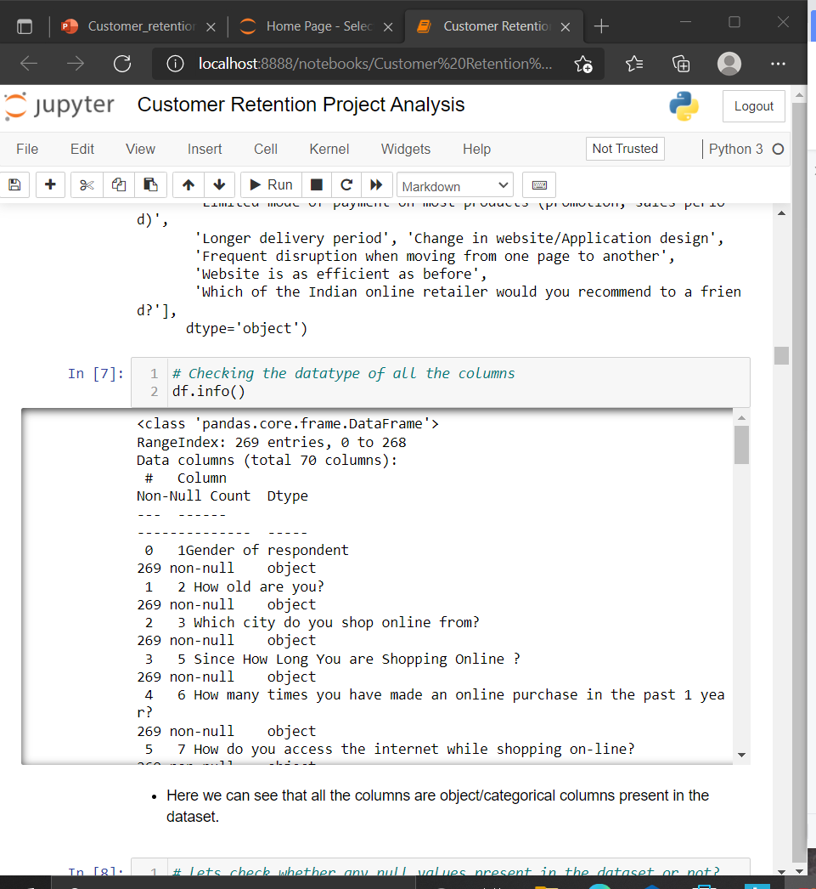
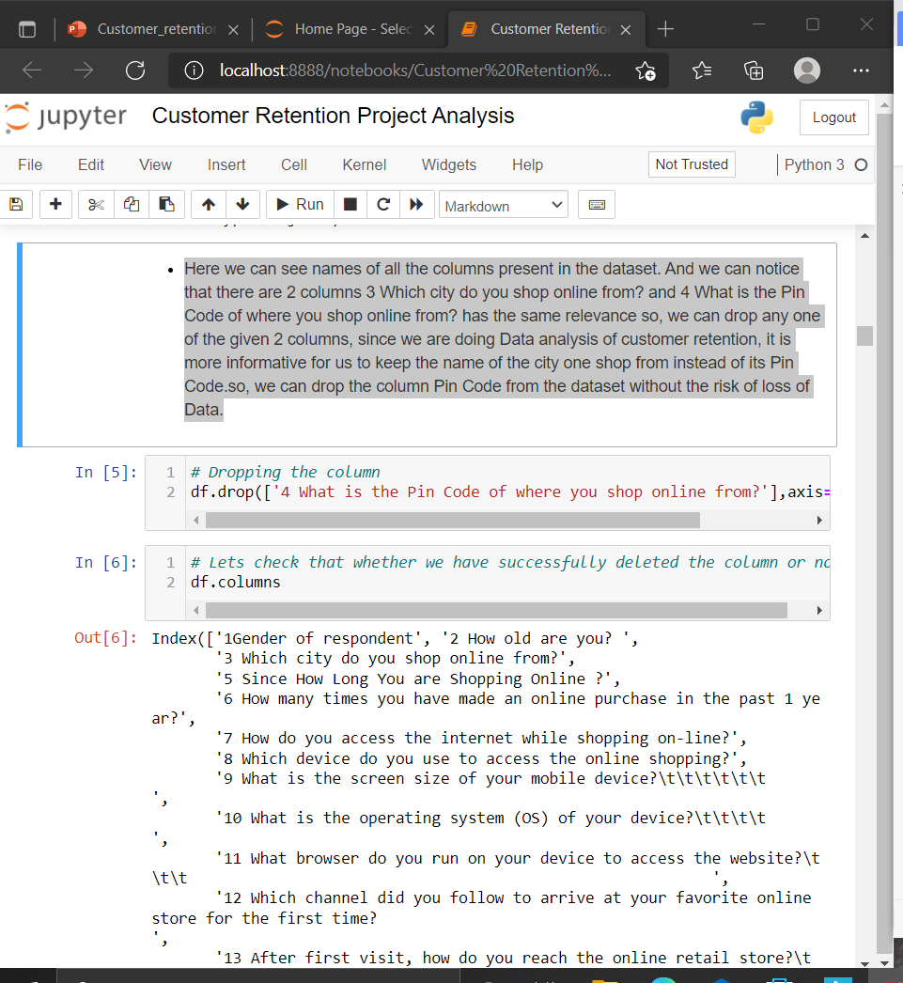
Droping the column and checking the dtype of all the columns
Here we can see that all the columns are object/categorical columns present in the dataset.

Slide 10
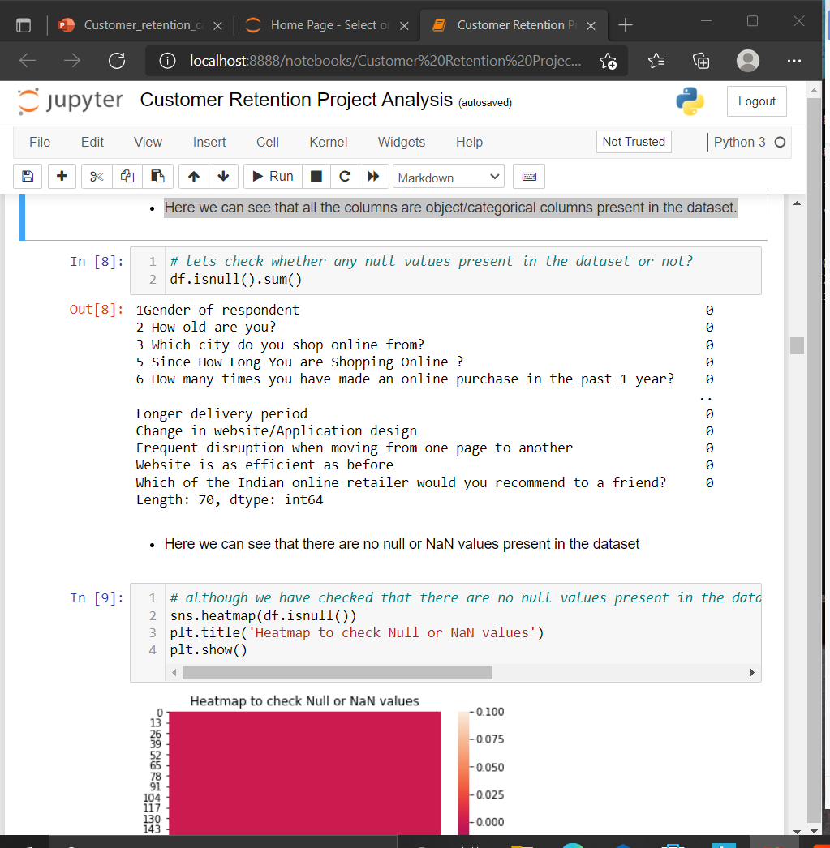
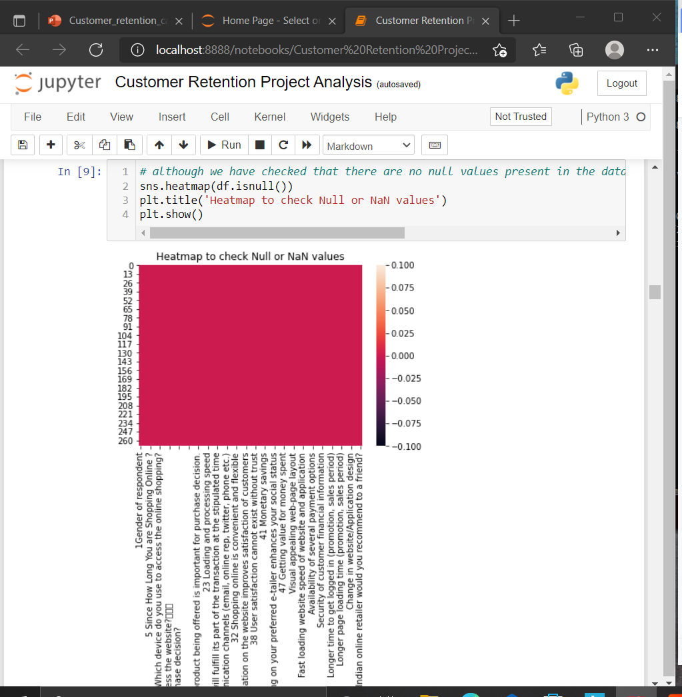
Checking Null or NaN Values
Here we can see that there are no null or NaN values present in the dataset
Even heatmap confirms that there are no null or NaN values present in the dataset

Slide 11
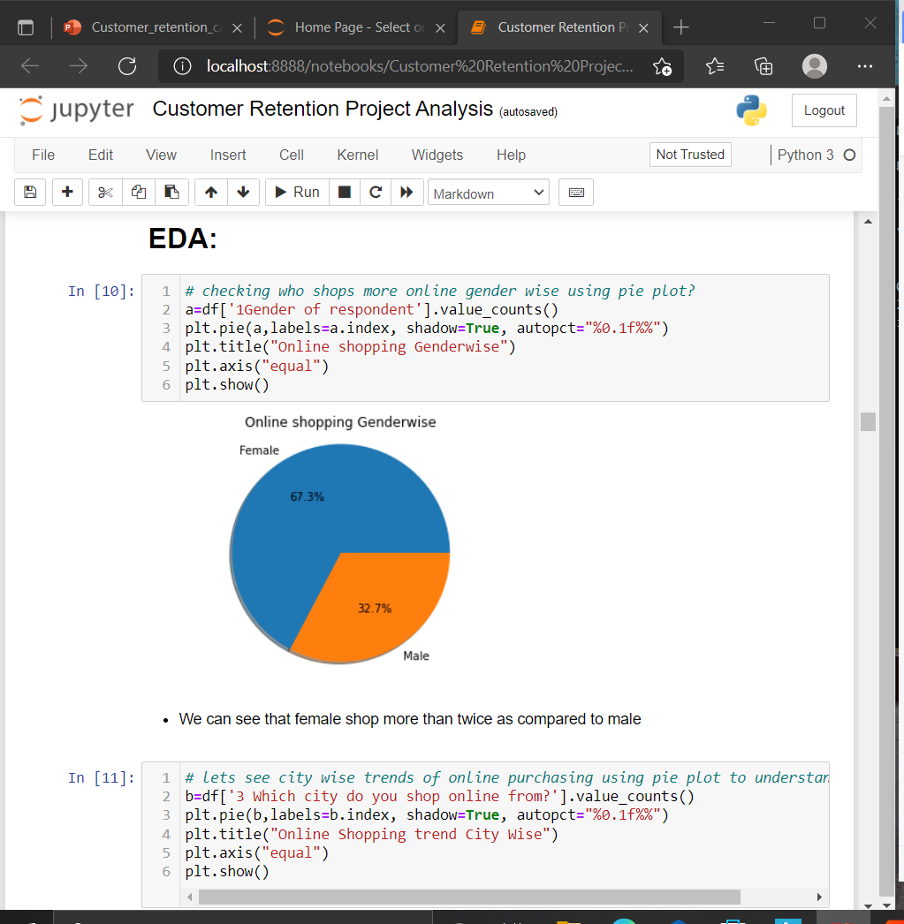
EDA: Univariate
We can see that female shop more than twice as compared to male

Slide 12
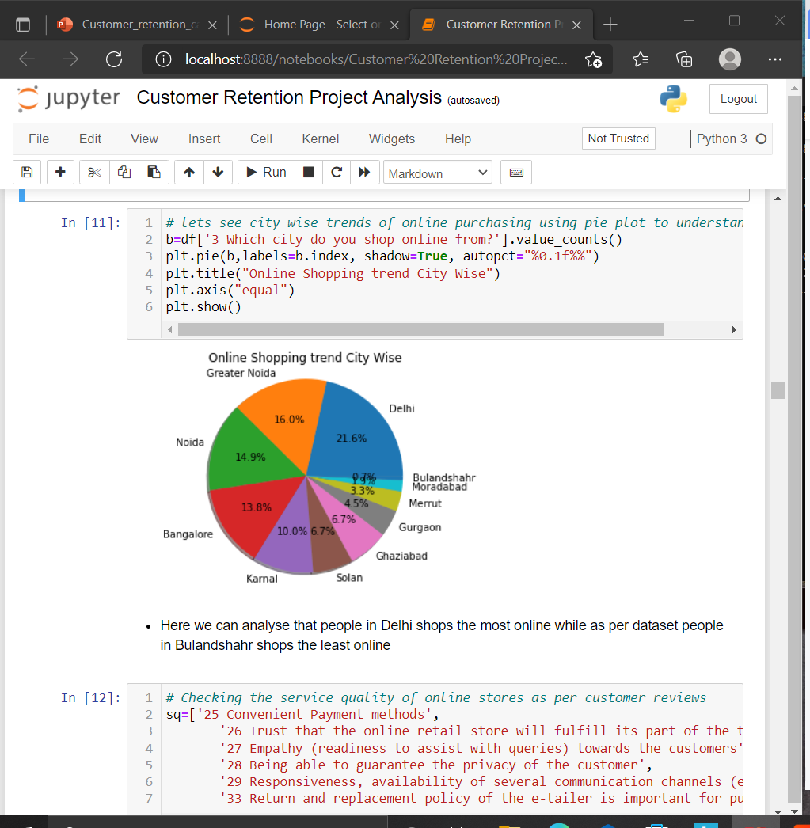
Here we can analyse that people in Delhi shops the most online while as per dataset people in Bulandshahr shops the least online

Slide 13
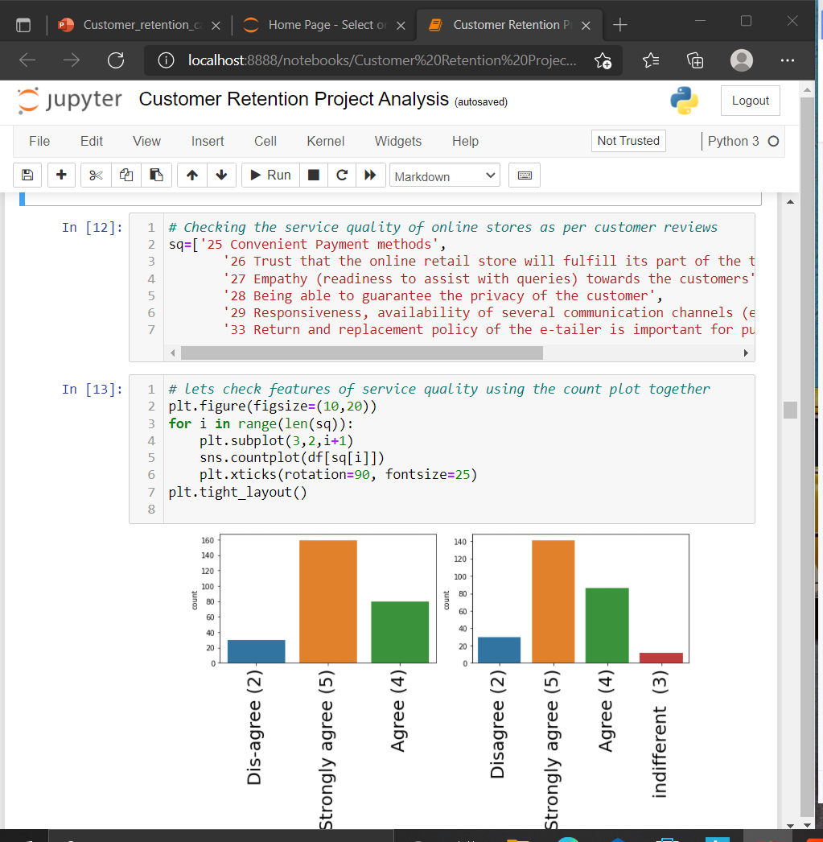
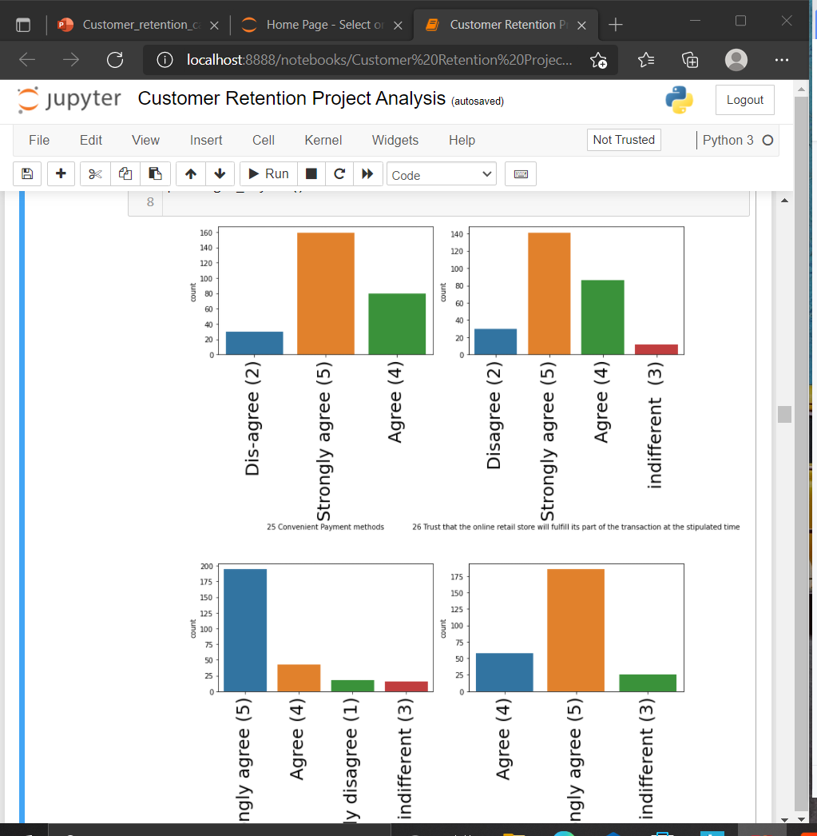
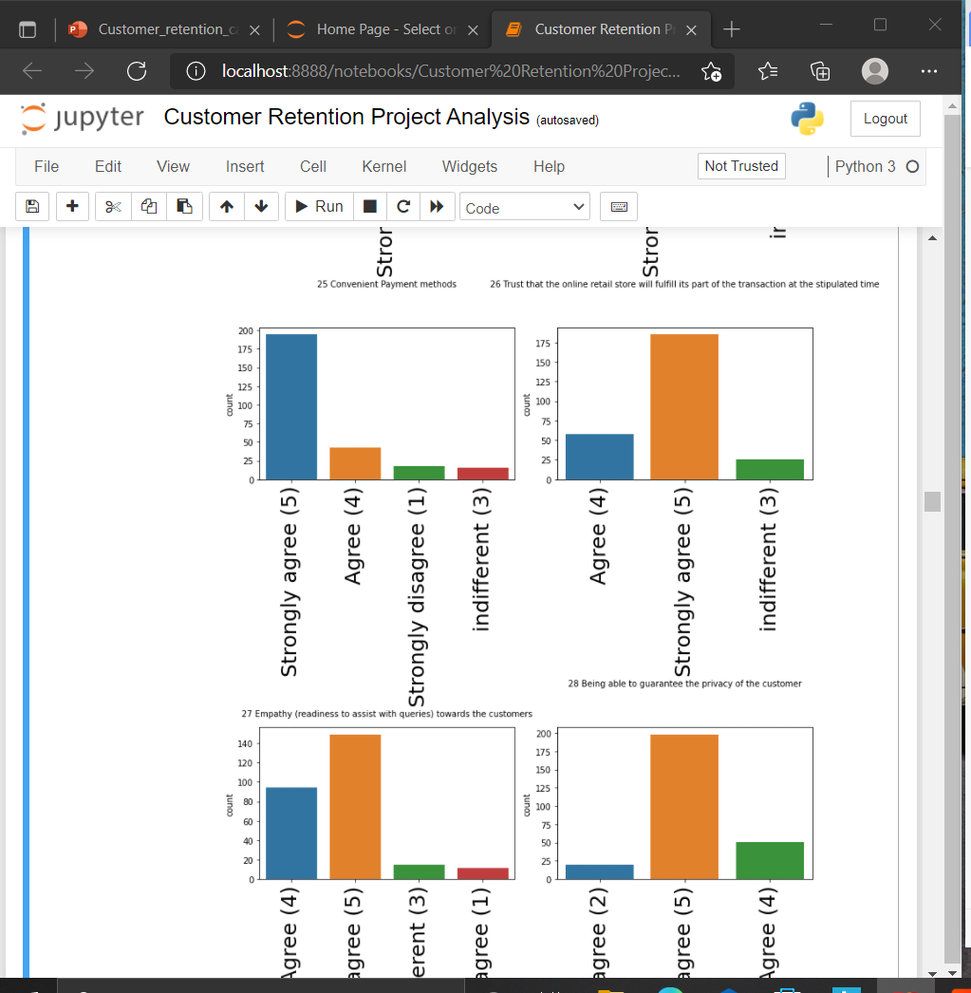
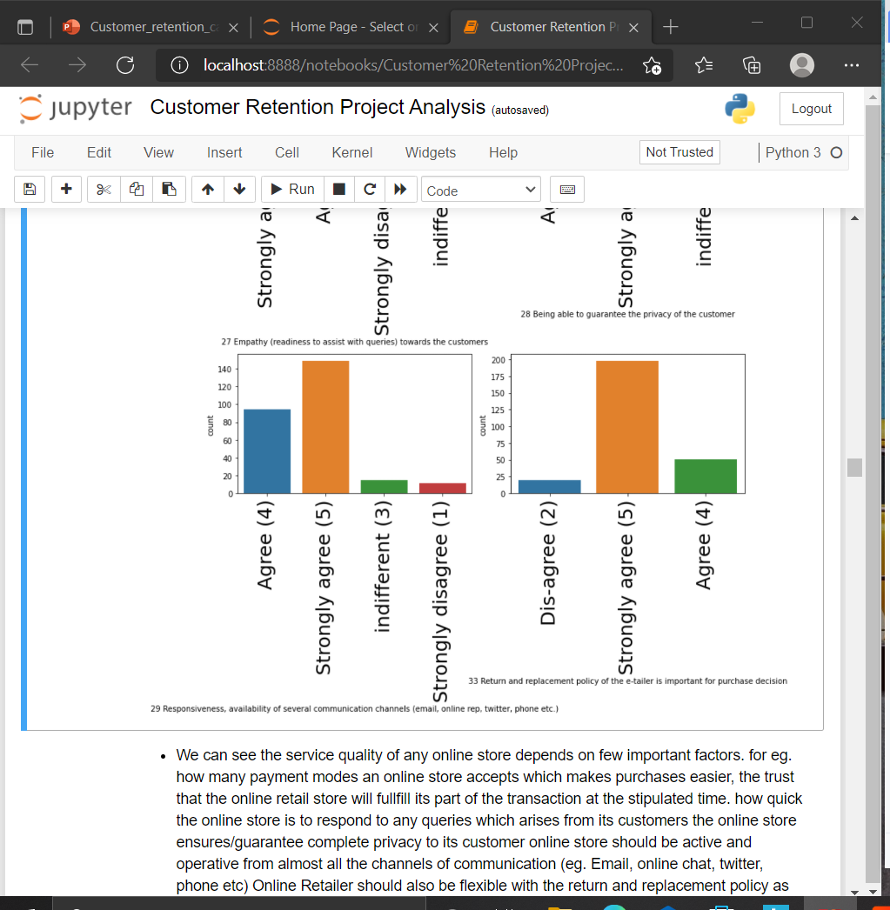
Checking Service Quality of Online Stores
We can see the service quality of any online store depends on few important factors. for eg. how many payment modes an online store accepts which makes purchases easier, the trust that the online retail store will fullfill its part of the transaction at the stipulated time. how quick the online store is to respond to any queries which arises from its customers the online store ensures/guarantee complete privacy to its customer online store should be active and operative from almost all the channels of communication (eg. Email, online chat, twitter, phone etc) Online Retailer should also be flexible with the return and replacement policy as well.

Slide 14
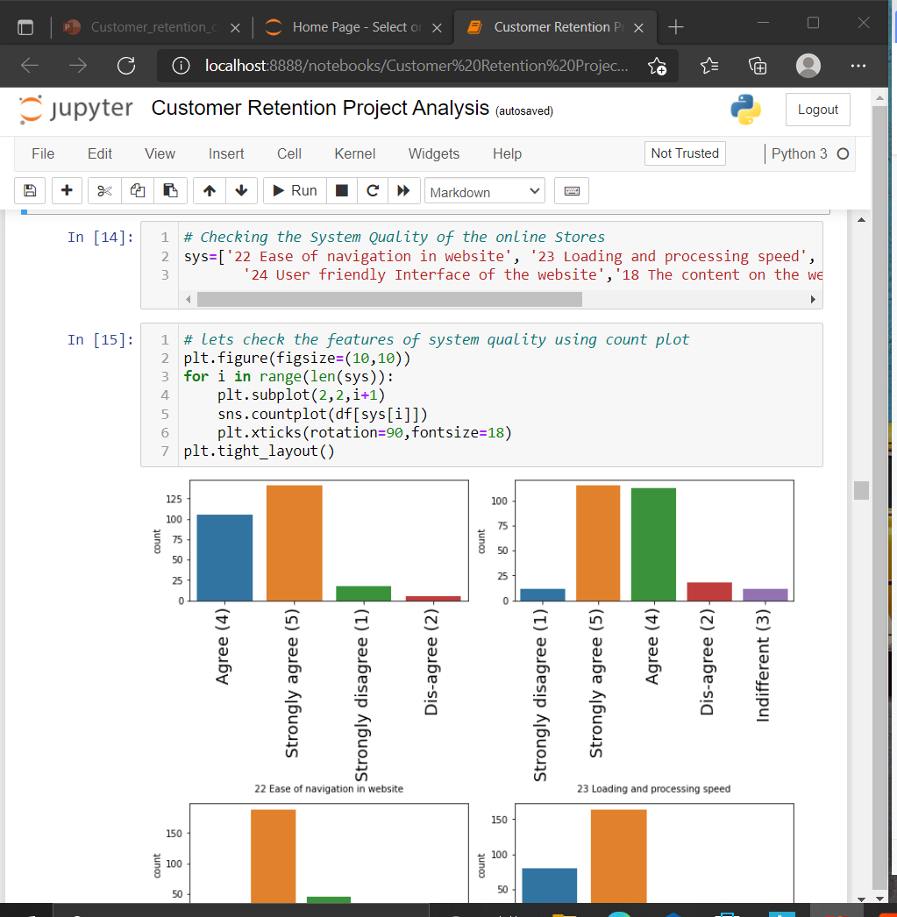
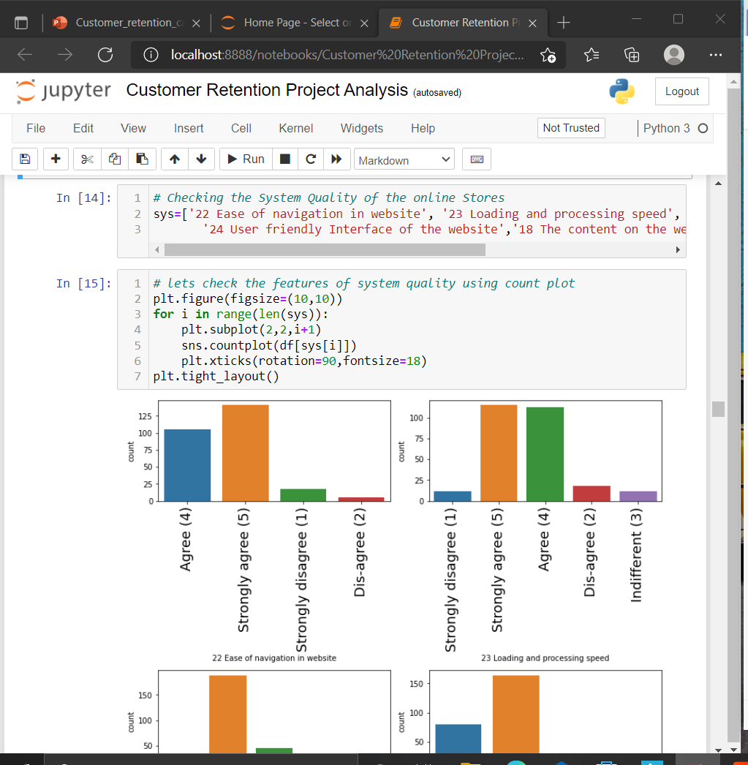
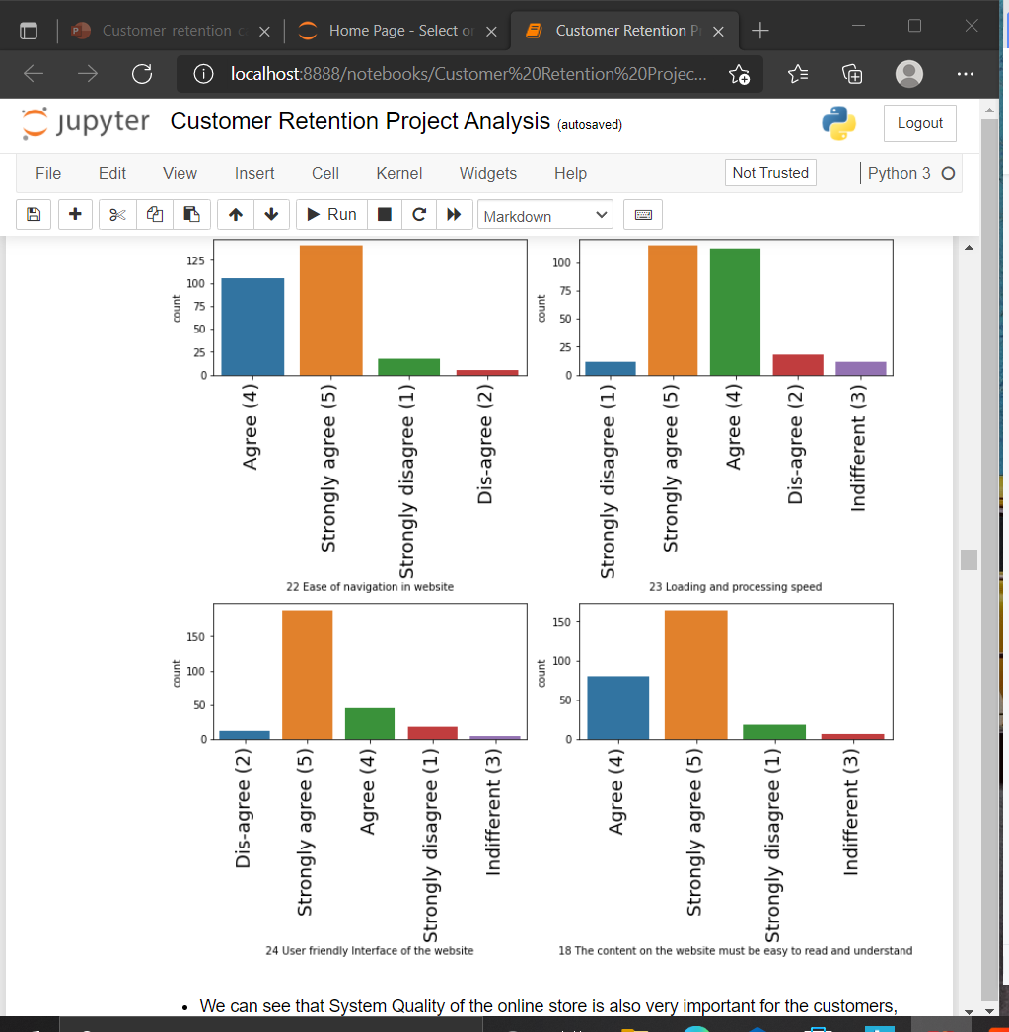
Checking the System Quality
We can see that System Quality of the online store is also very important for the customers, Ease of Navigation through the website, the loading speed and processing time should be fairly quick, The content provided on the website must be easy to read and understand, and the interface should be very user friendly so that, customers wont face any issues while accessing the website.

Slide 15
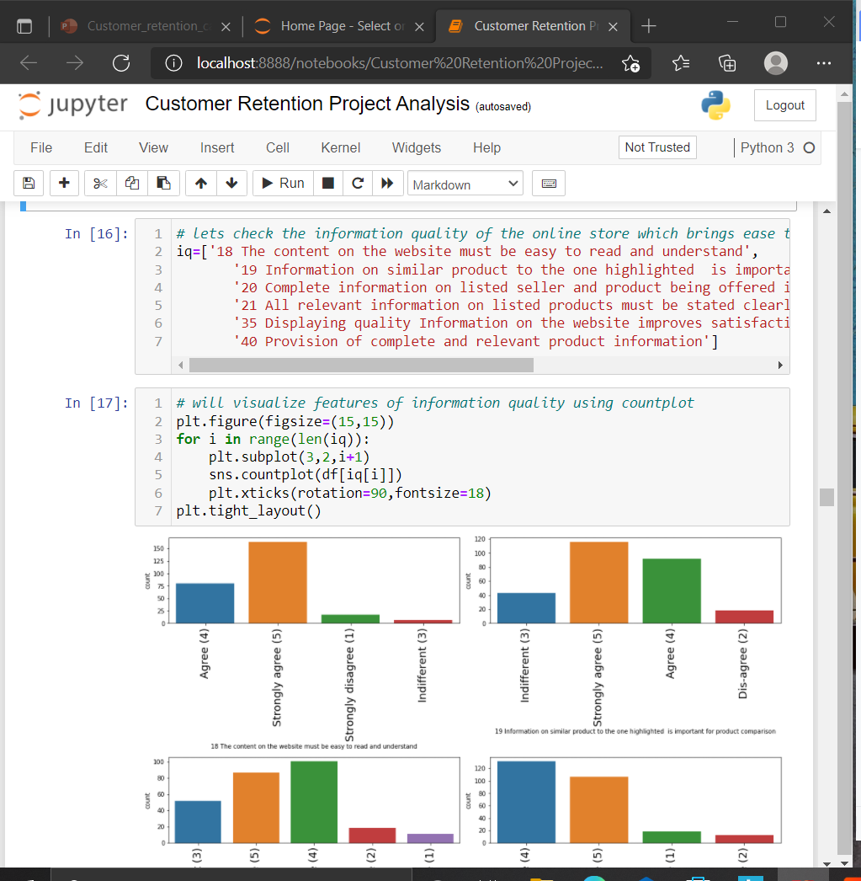
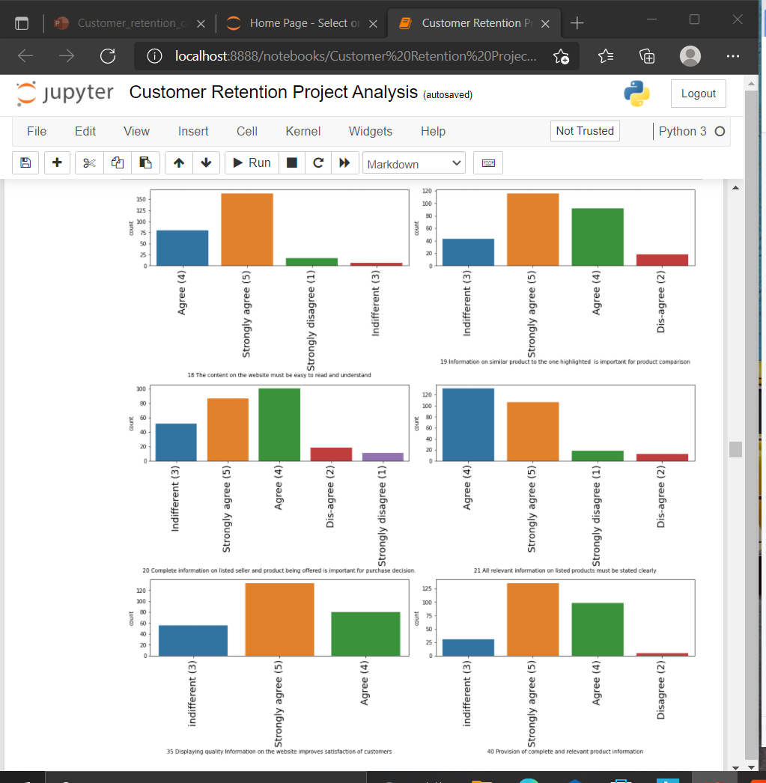
Information Quality
we can see how important it is to display relevant information on the online retail store. For all the online stores it is very important to work on providing good information quality on there website, so that customer can easily access all the required information and based on that complete his/her online purchasing. The detailed and informative content on the website helps the customers whether to shop from that particular online store or not.

Slide 16
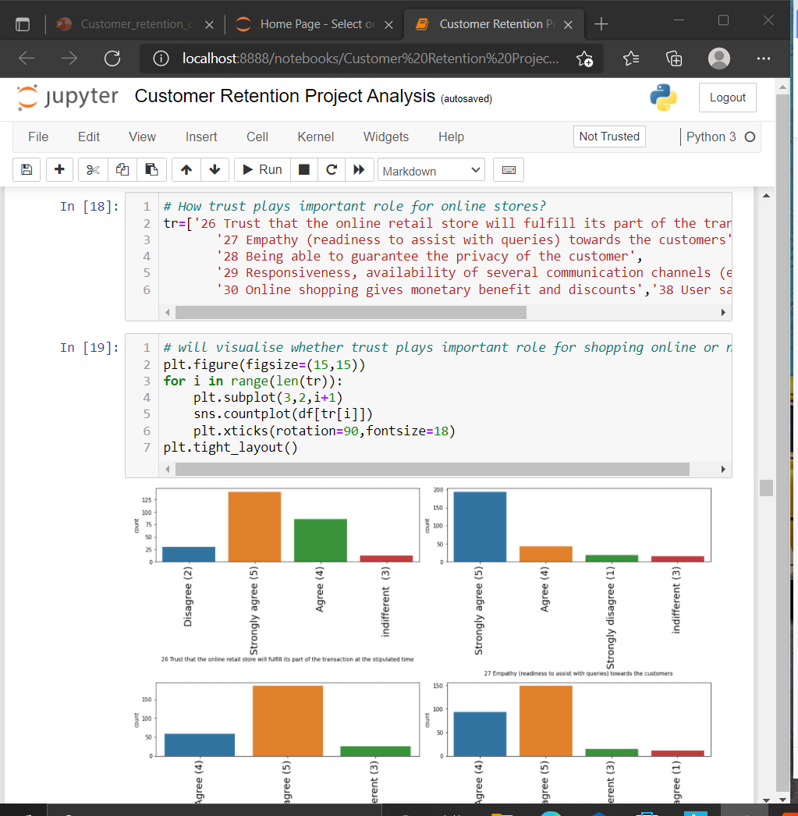
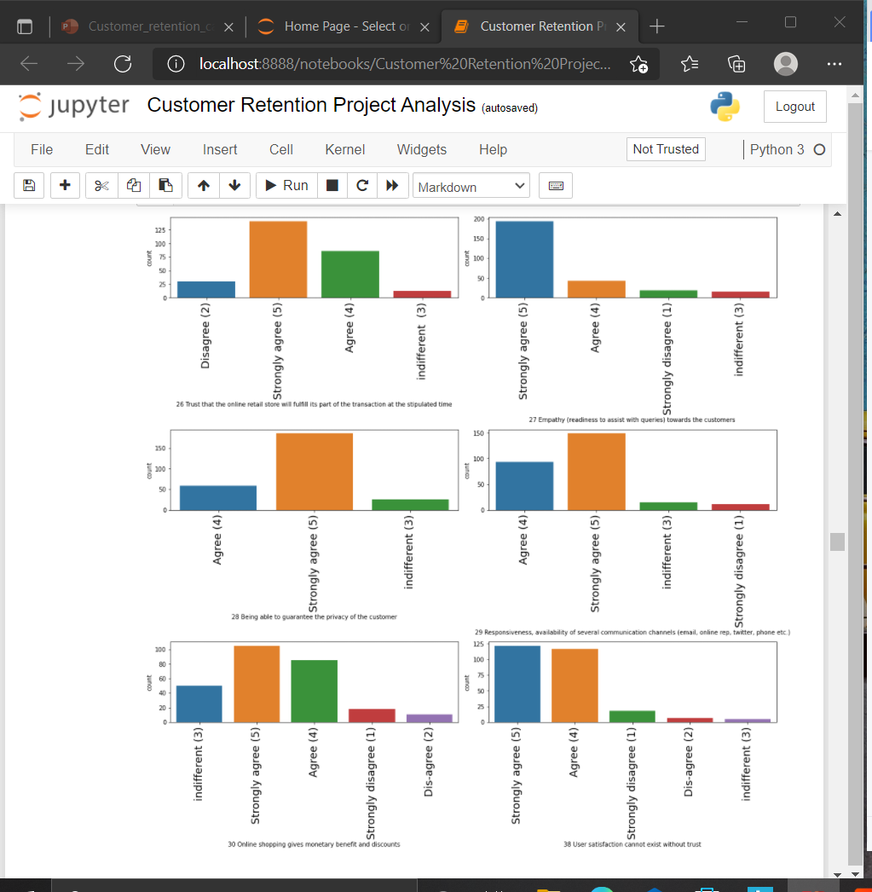
Trust of customers
Here we can see that Trust plays very important role for customers to buy anything from online stores. so, online stores should enhance there quality experince and make there website very safe and secure to retain there customers and bring them back again and again to shop online hazzlefree. customers trust the online stores which are easy to communicate to, so that whenever they stuck they can easily contact online store through various communication channels.customers trust also depends upon how quickly you can complete your transaction / deliver. Customers also trust the online stores who keeps secure there privacy and also provide secured payment gateway too. Online stores can also win Trust of there Customers by providing them the best discounts or best price for the products/ Services they shop through the online stores. moreover User Satisfaction cannot exist without Trust Factor. So, Online stores must keep on updating and upgrading there stores, services and most important there privacy and secure policy frequently.

Slide 17
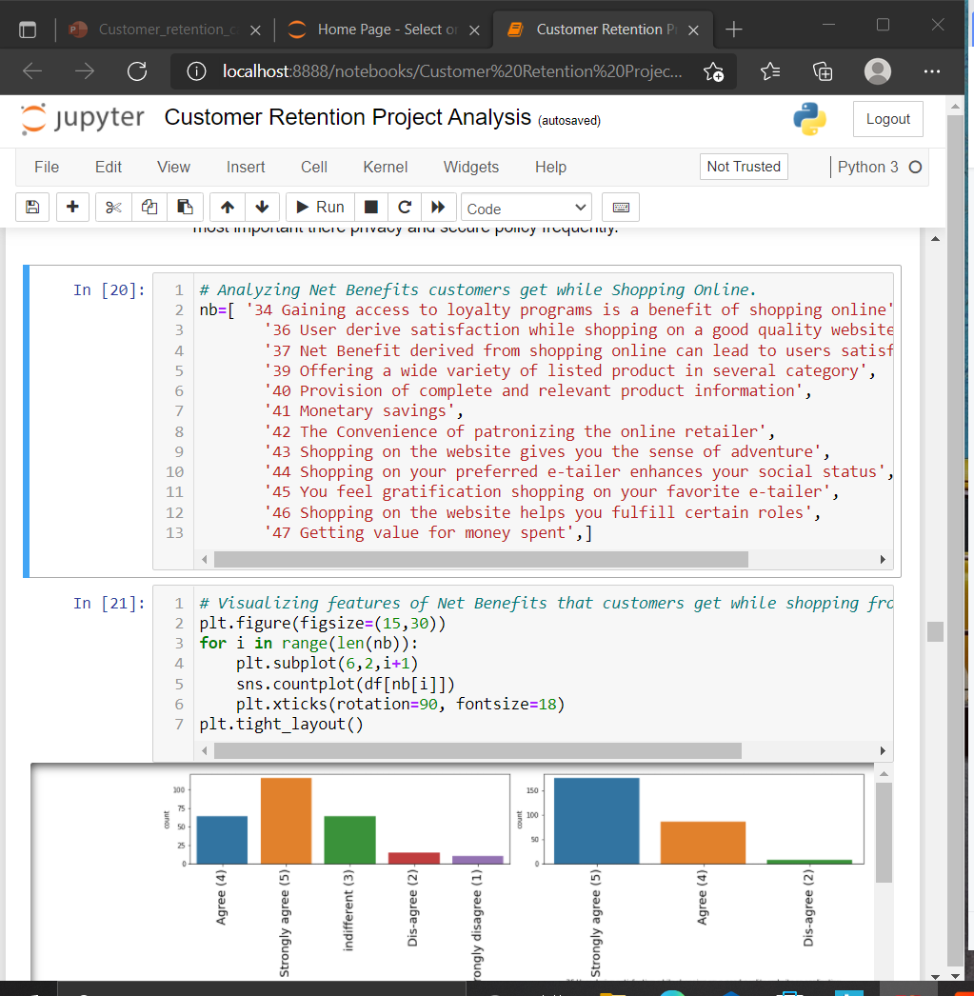
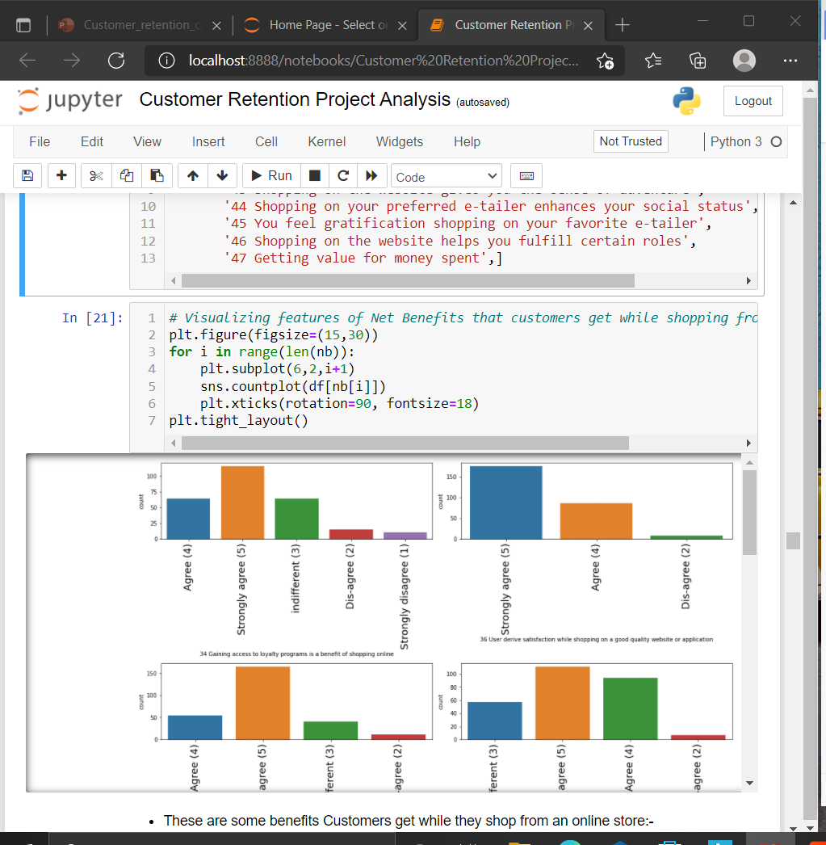
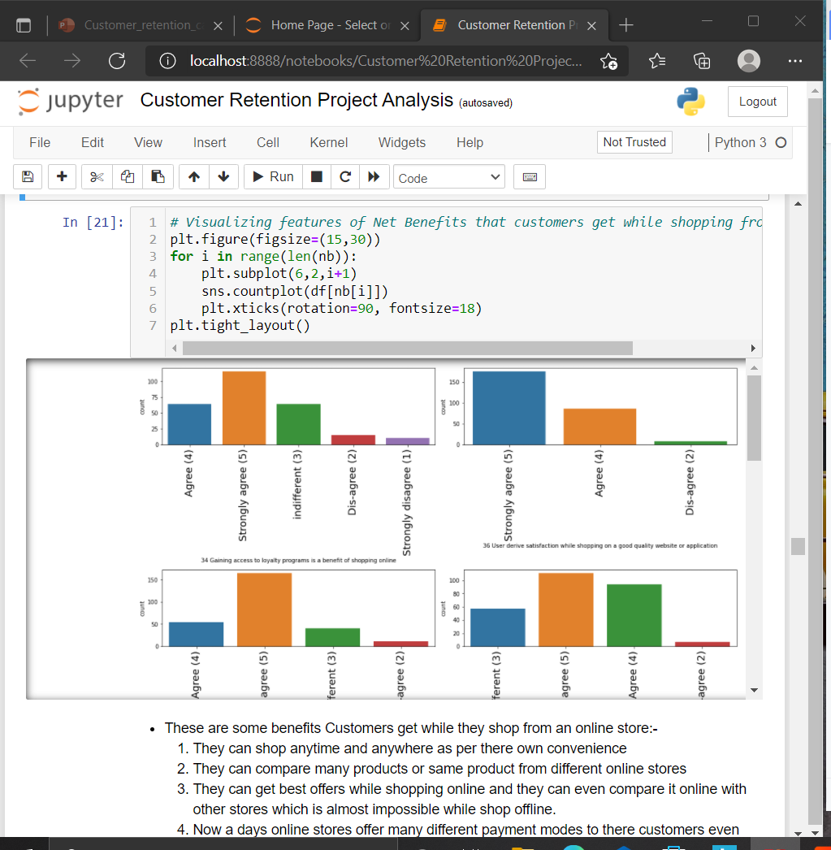
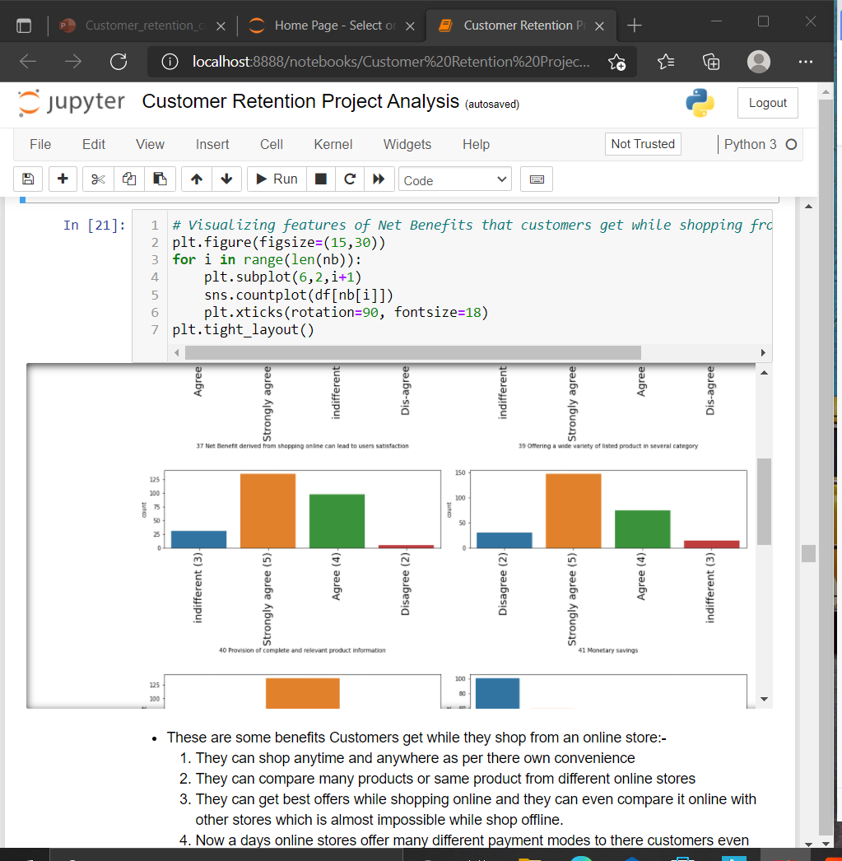
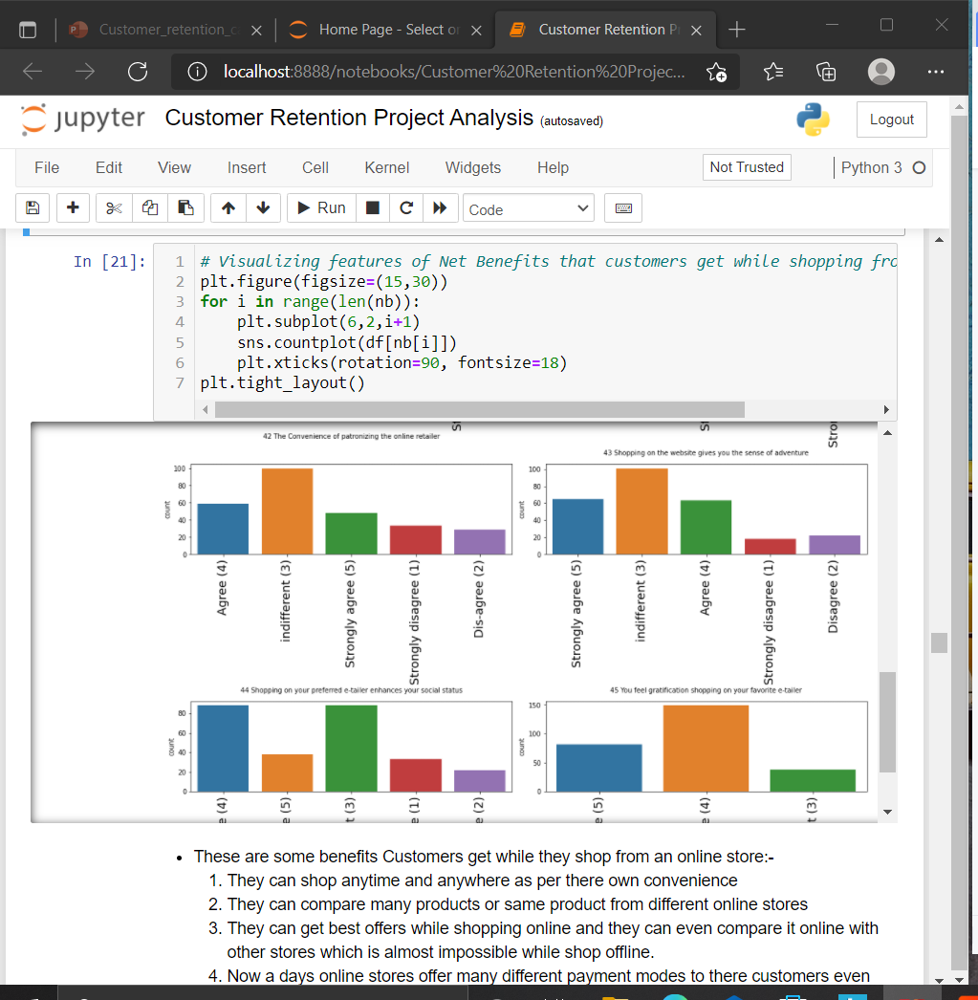
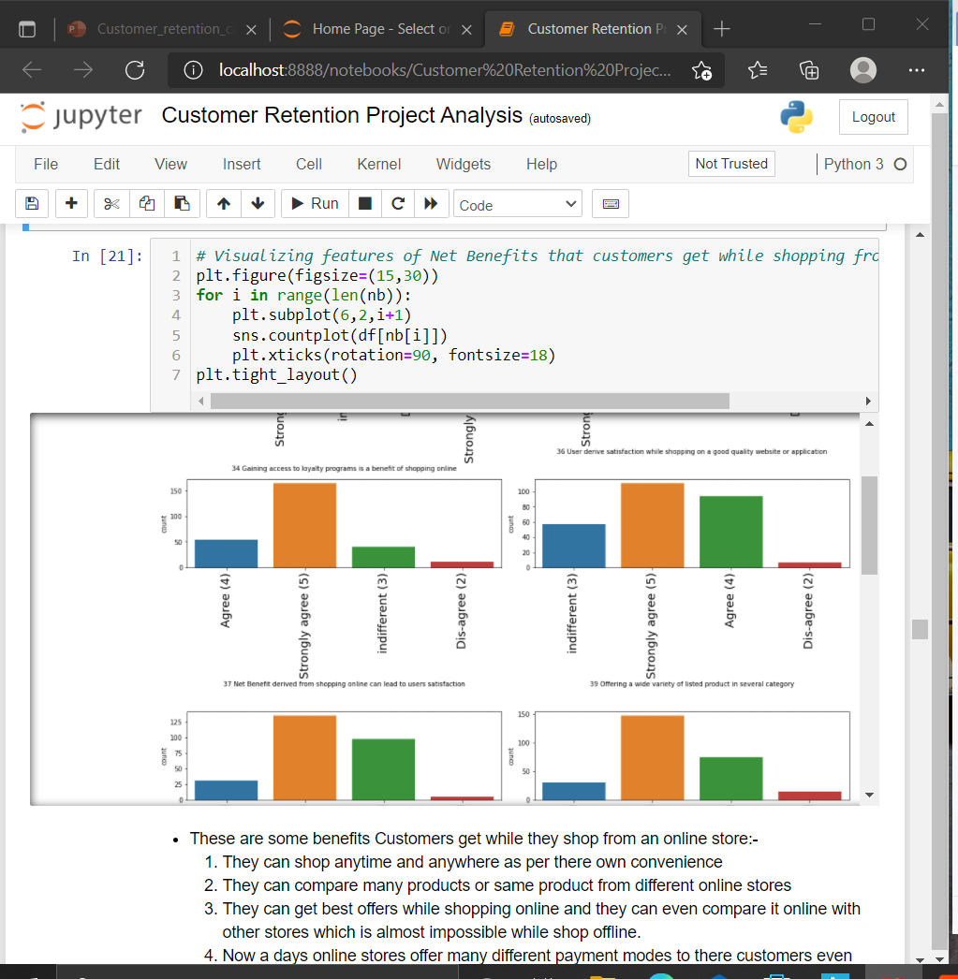
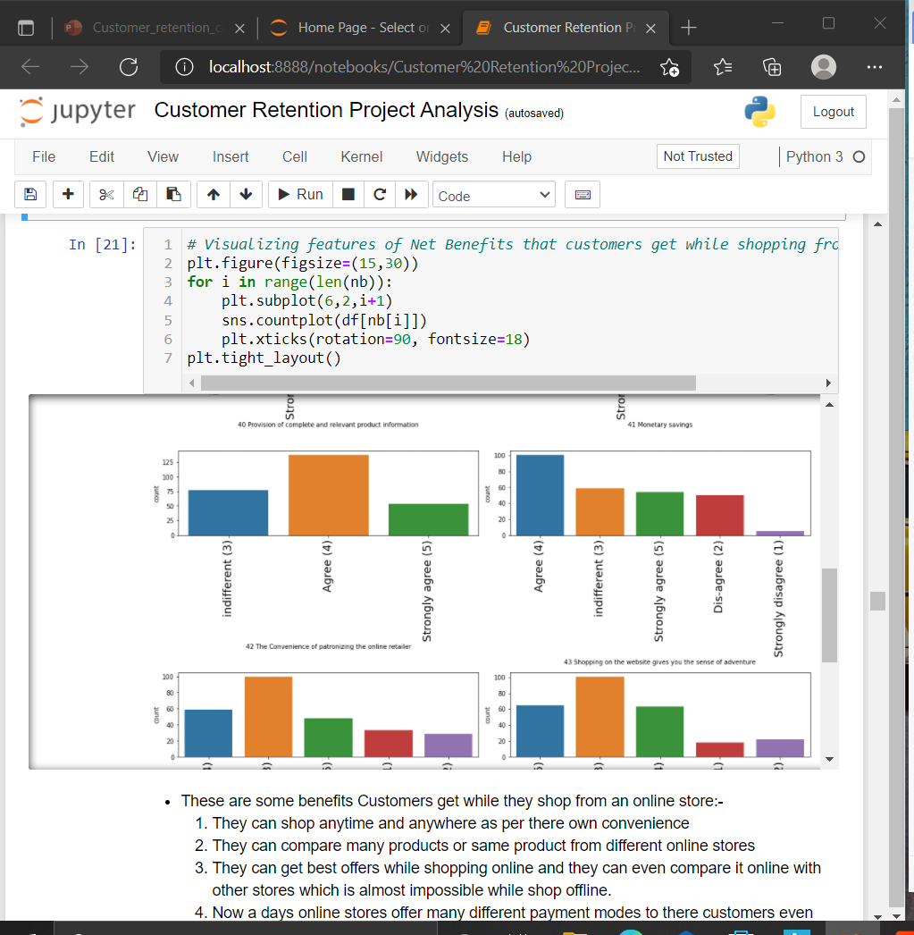
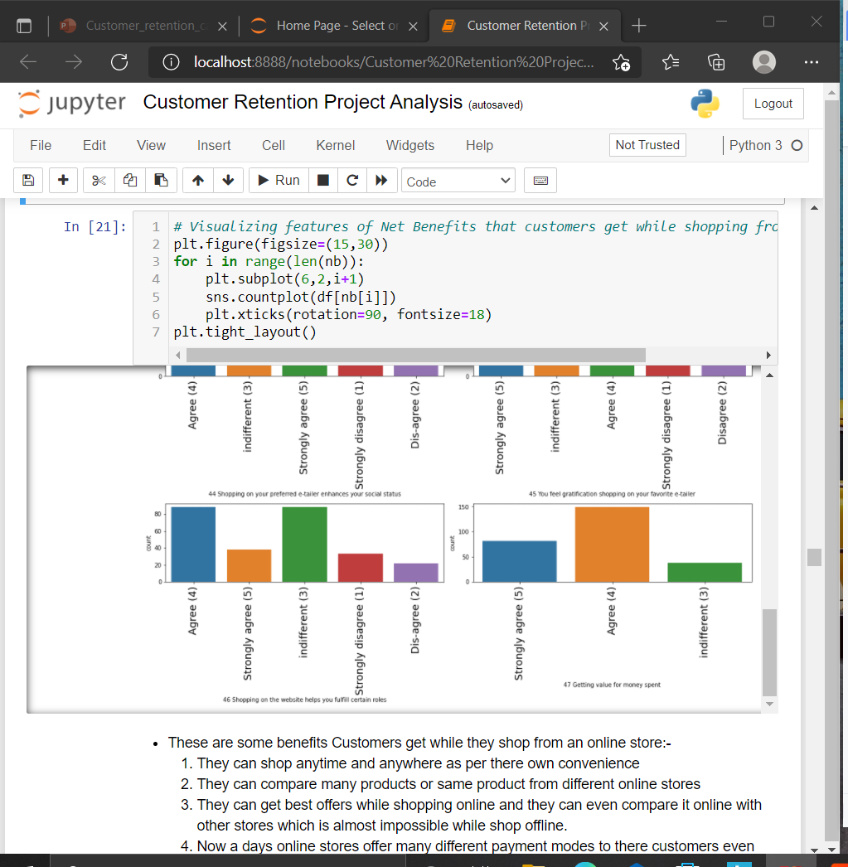
Net Benefits
These are some benefits Customers get while they shop from an online store:-
They can shop anytime and anywhere as per there own convenience
They can compare many products or same product from different online stores
They can get best offers while shopping online and they can even compare it online with other stores which is almost impossible while shop offline.
Now a days online stores offer many different payment modes to there customers even pay on delivery and pay later.
They can exchange/return as per there convinence while working at office or sitting at home.
Biggest benefit of shopping online is it saves lot of time and energy which can be used where it is required the most.

Slide 18
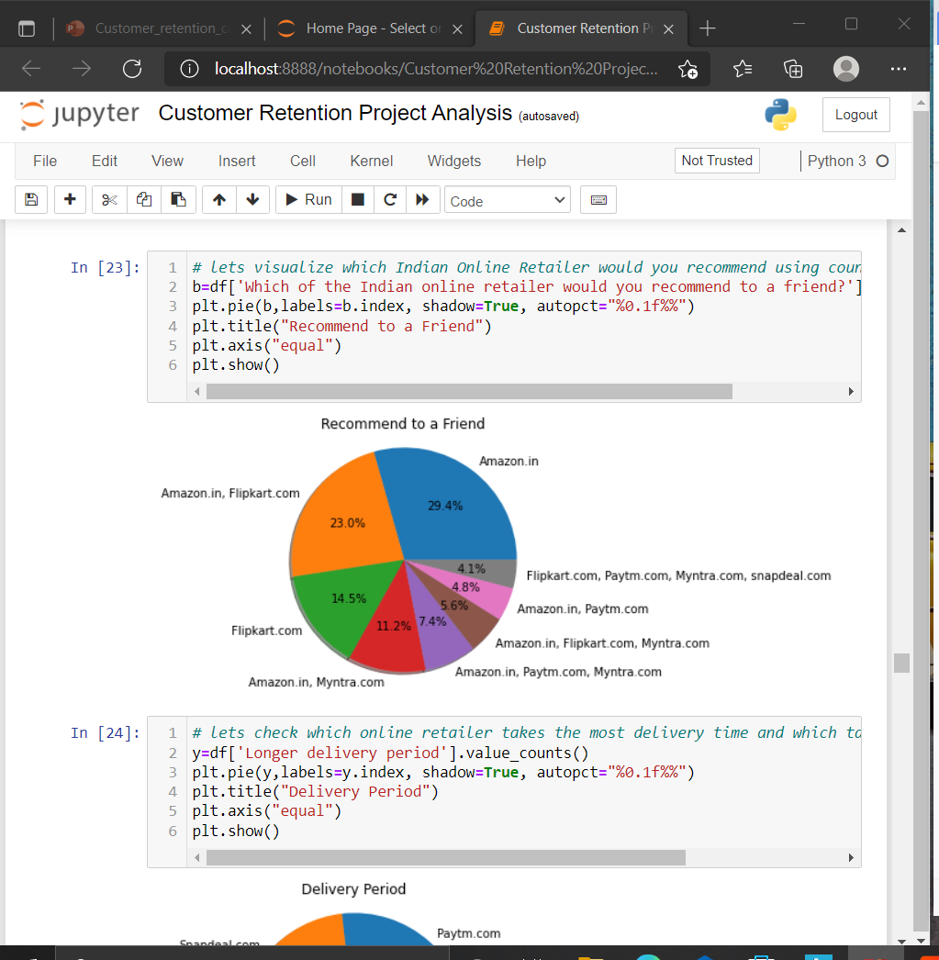
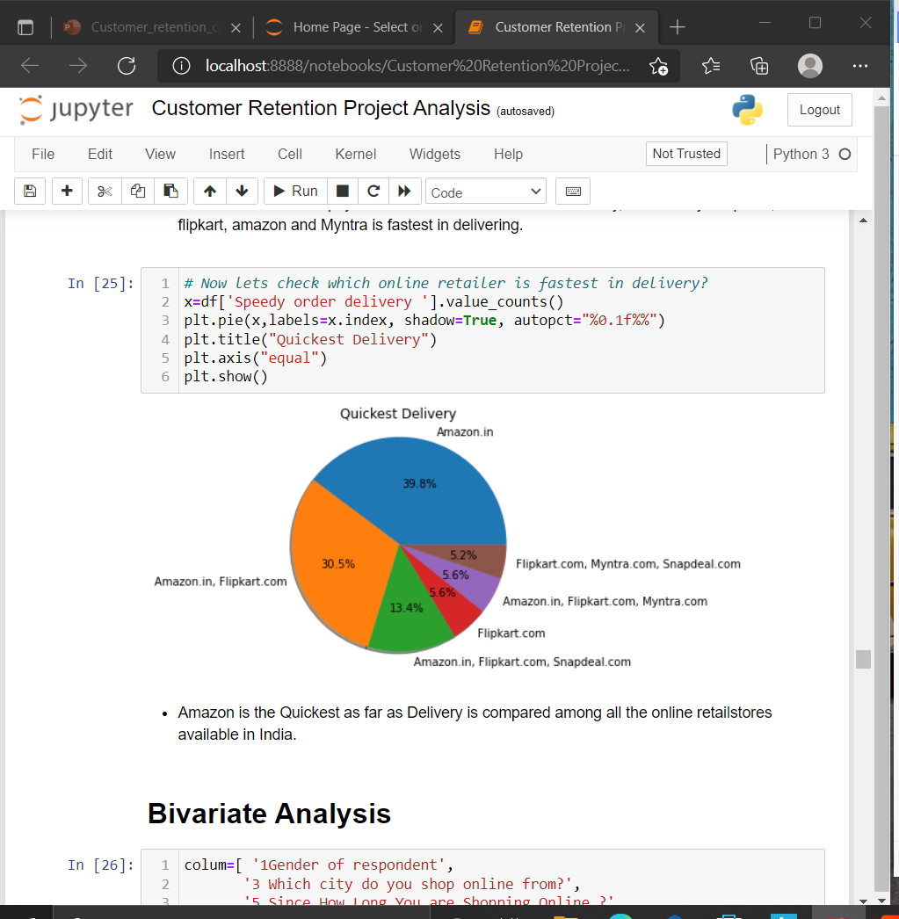
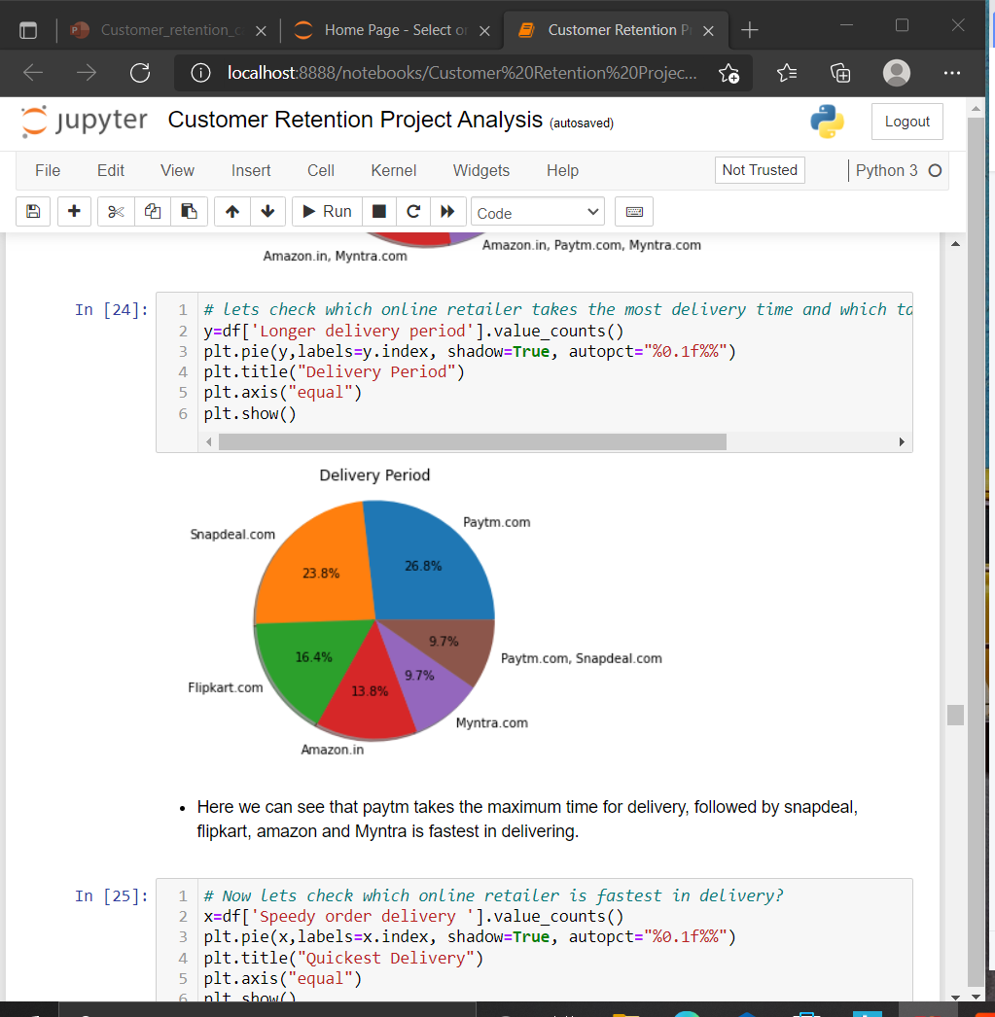
Indian Online Retailers Visualization

Slide 19
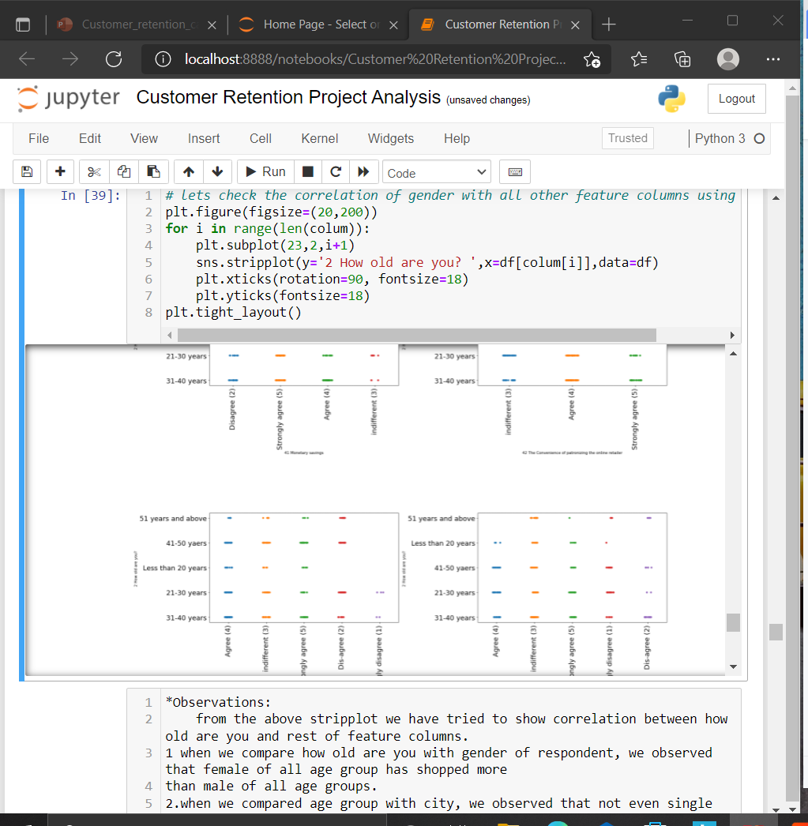
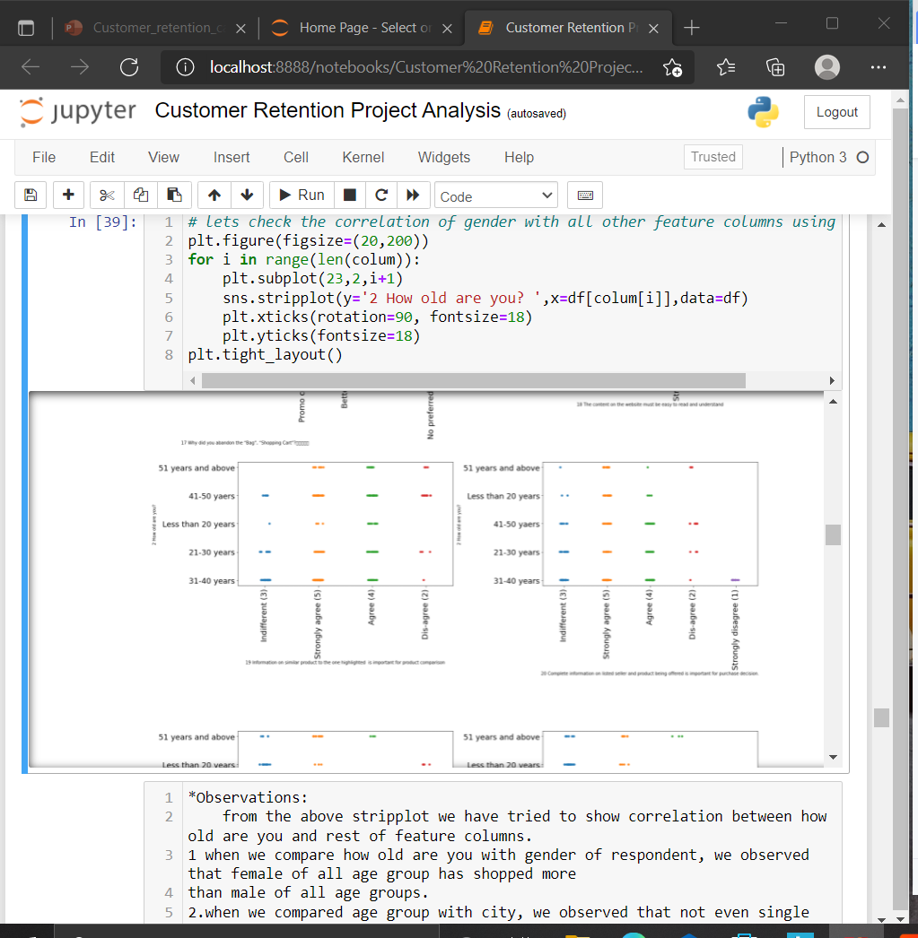
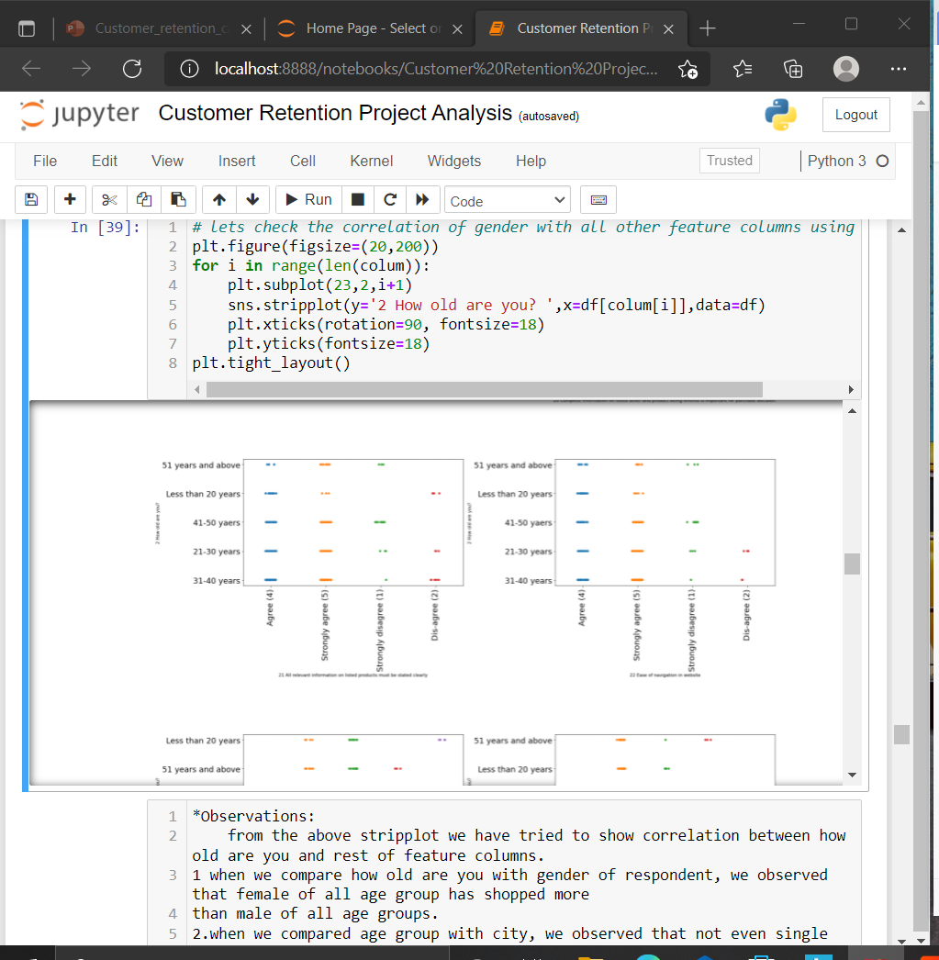
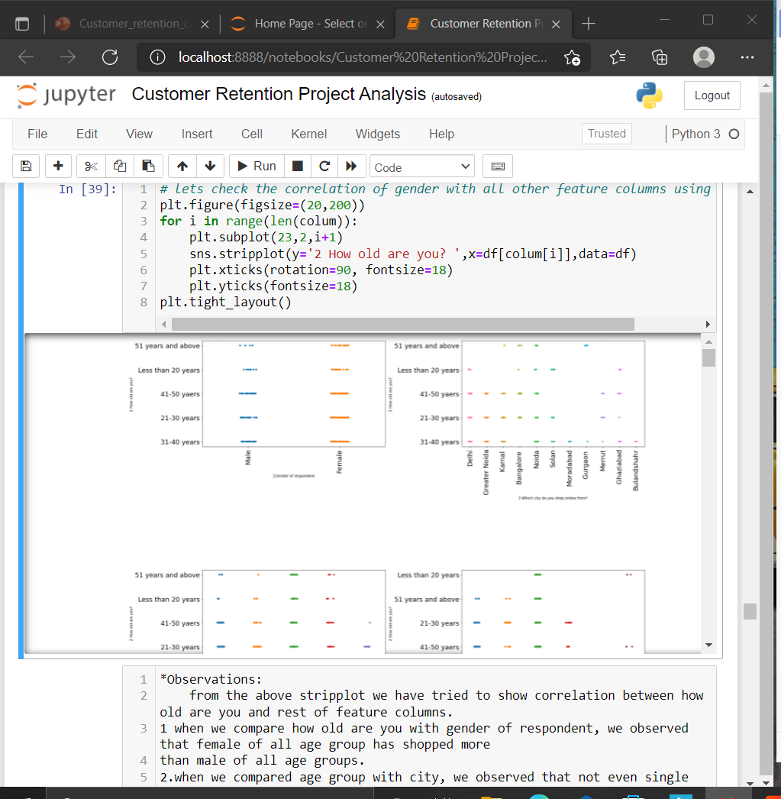
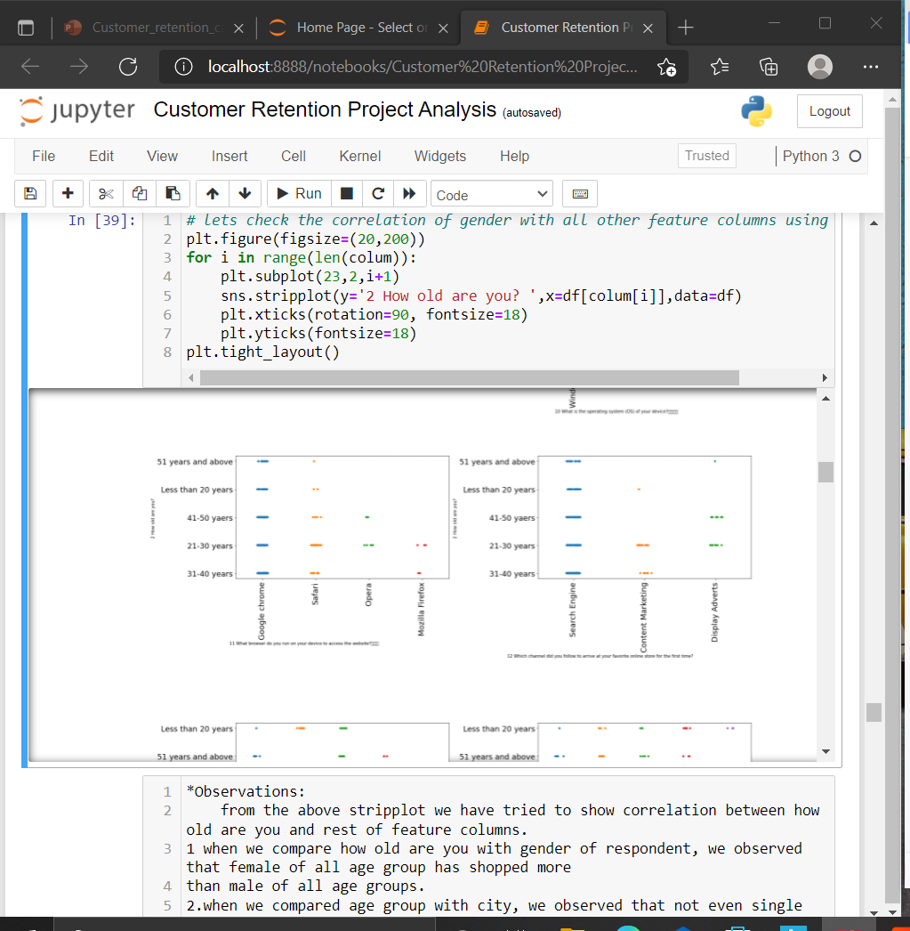
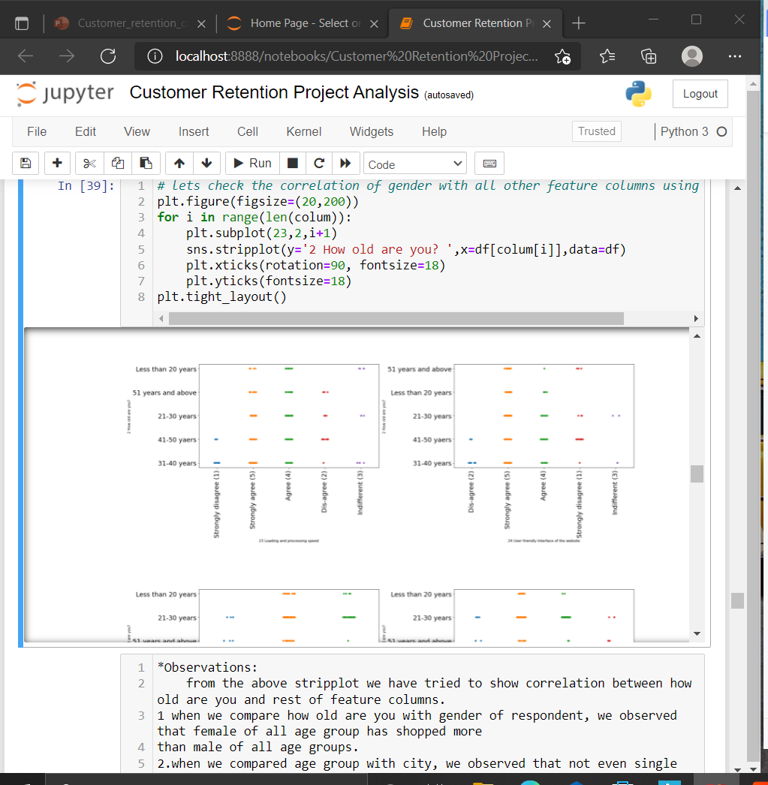
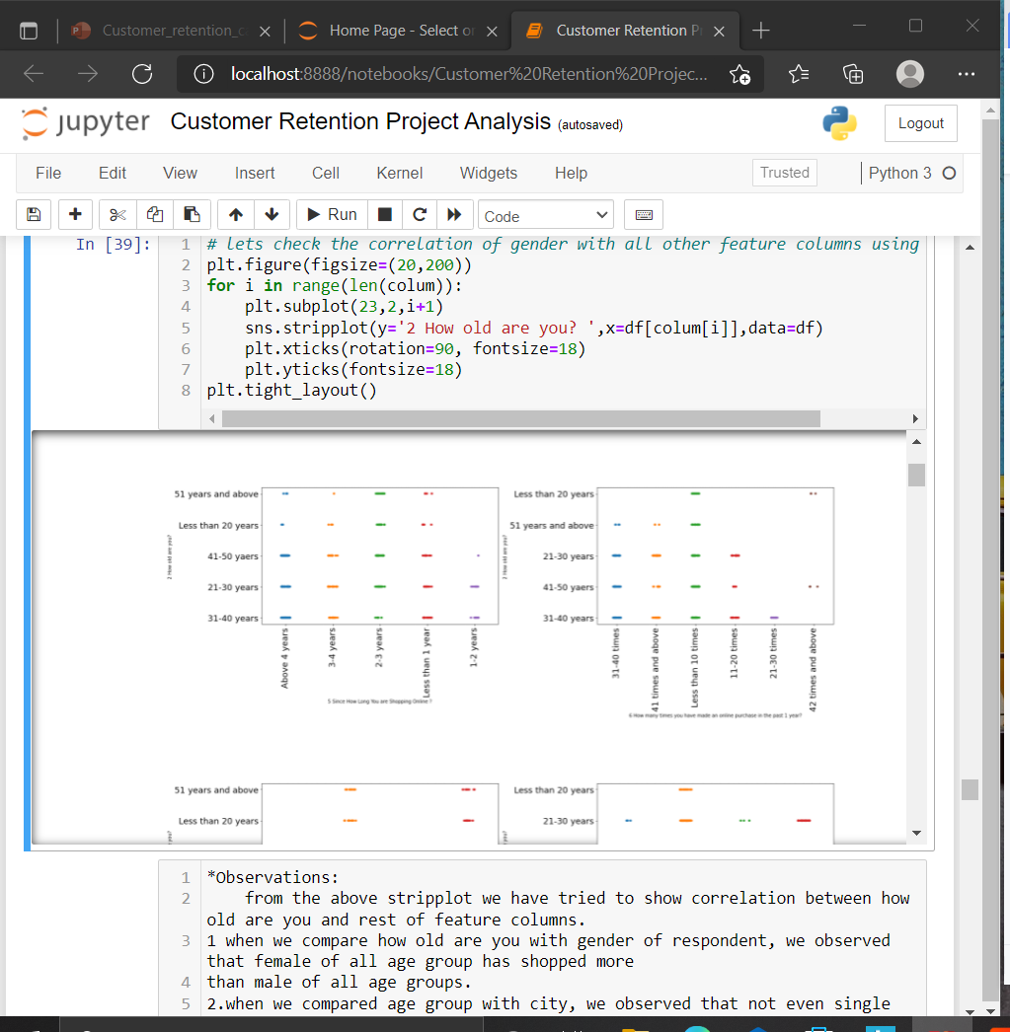

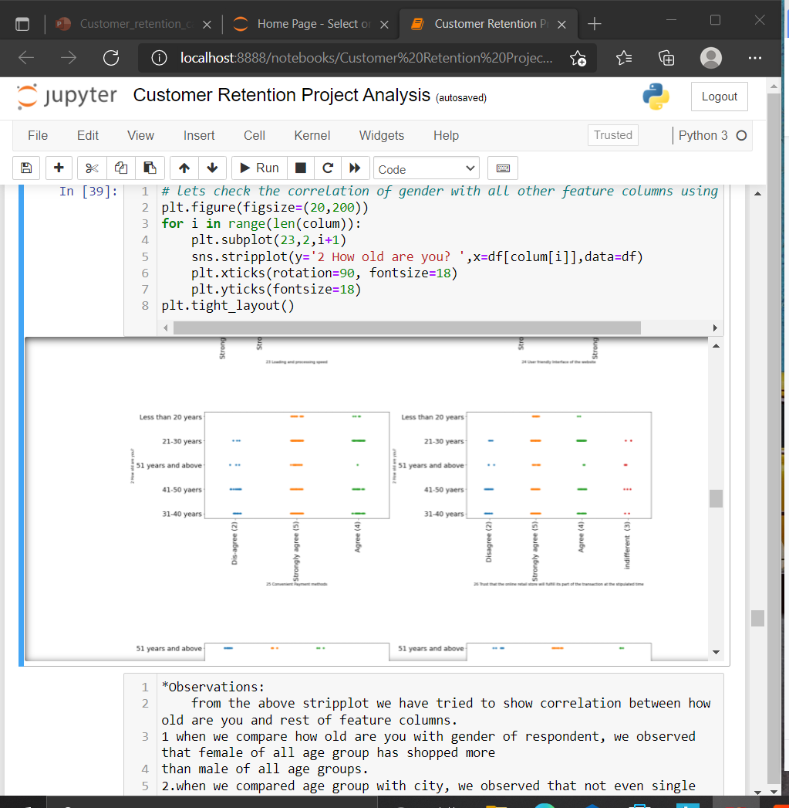
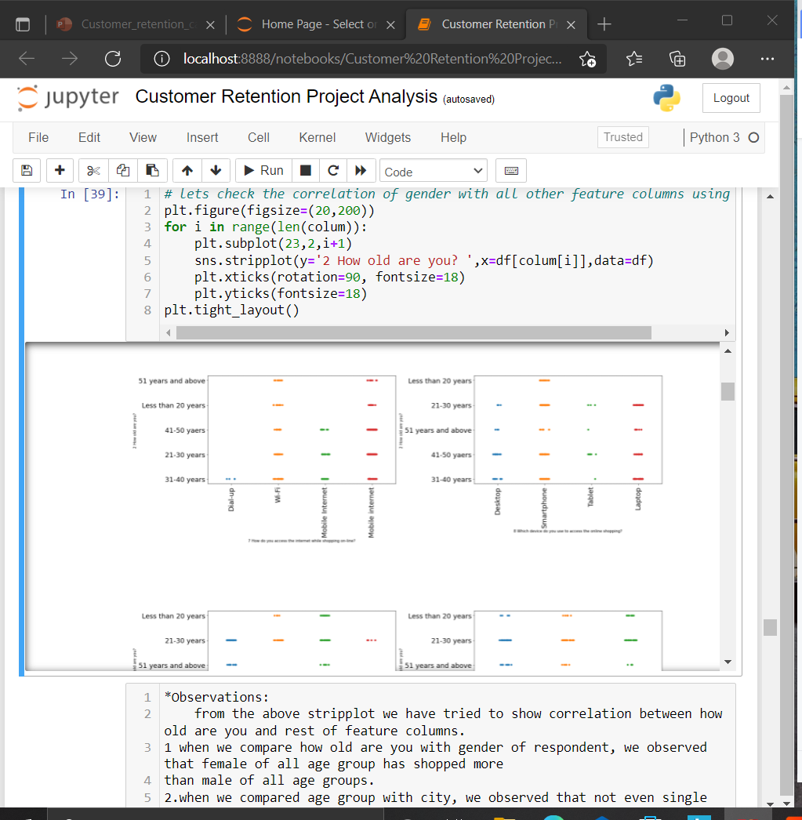
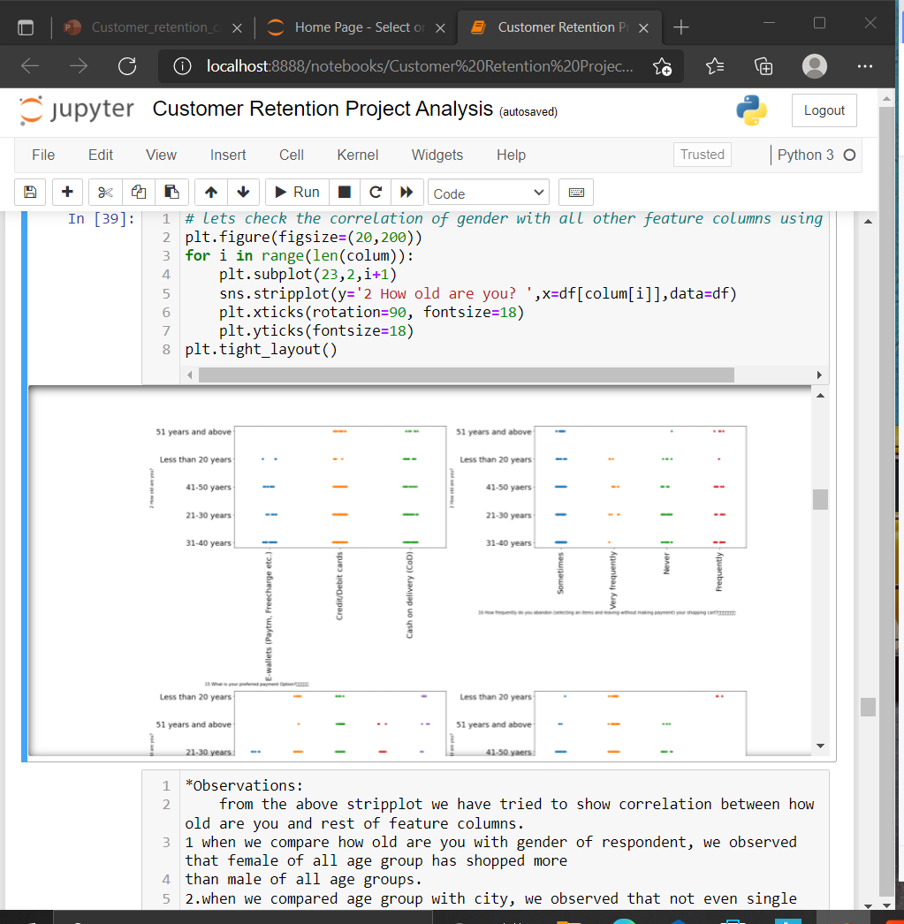
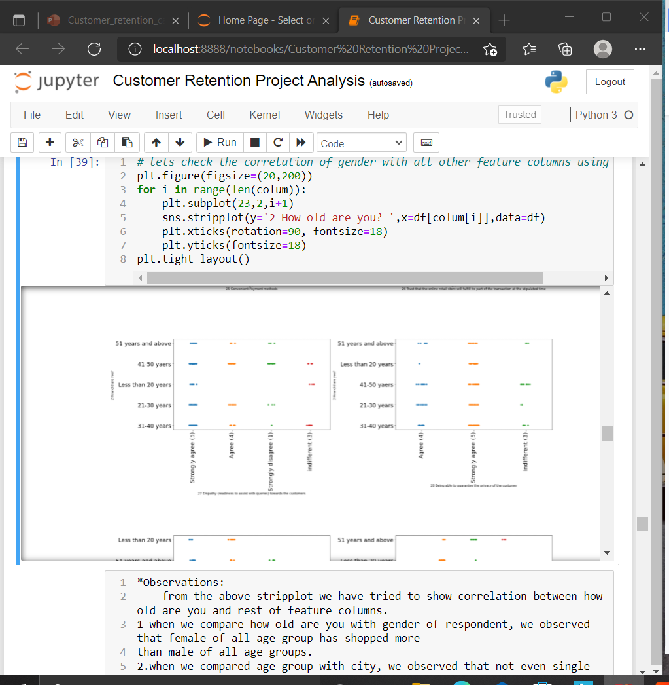

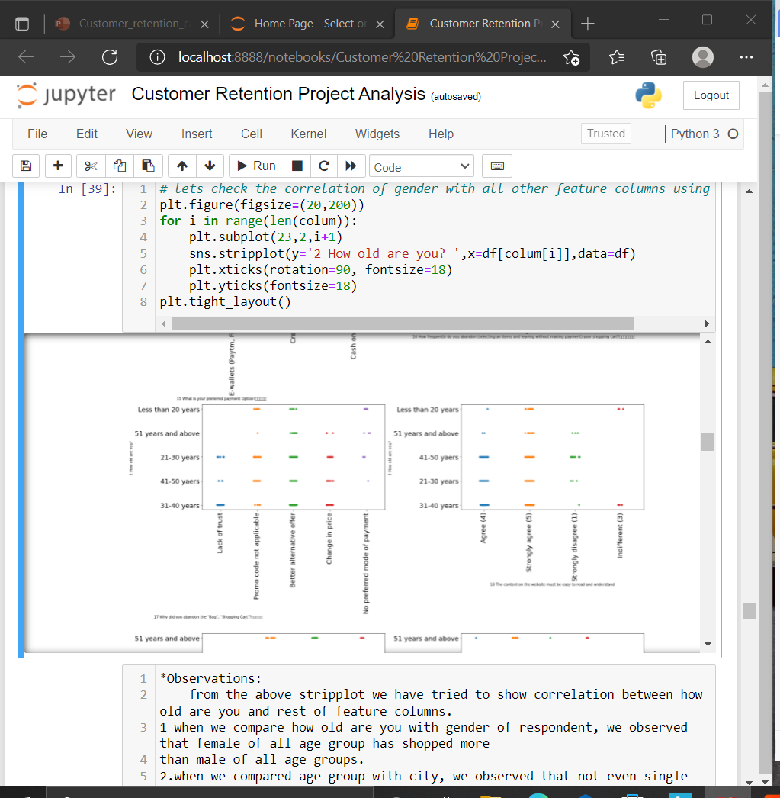
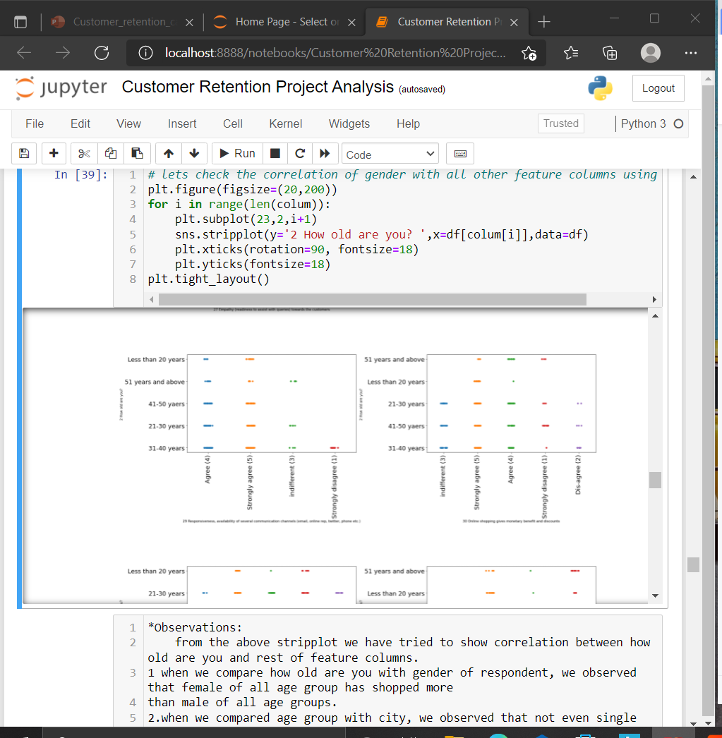
Bivariate Analysis

Slide 20
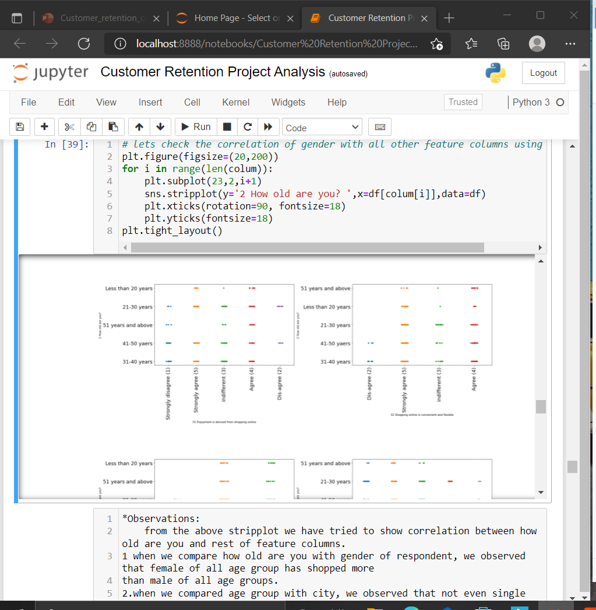
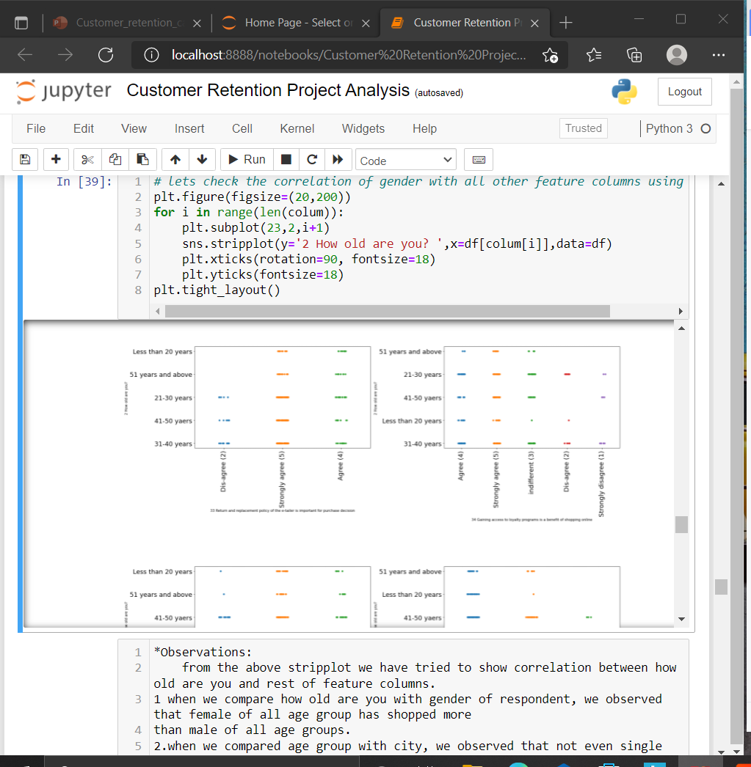

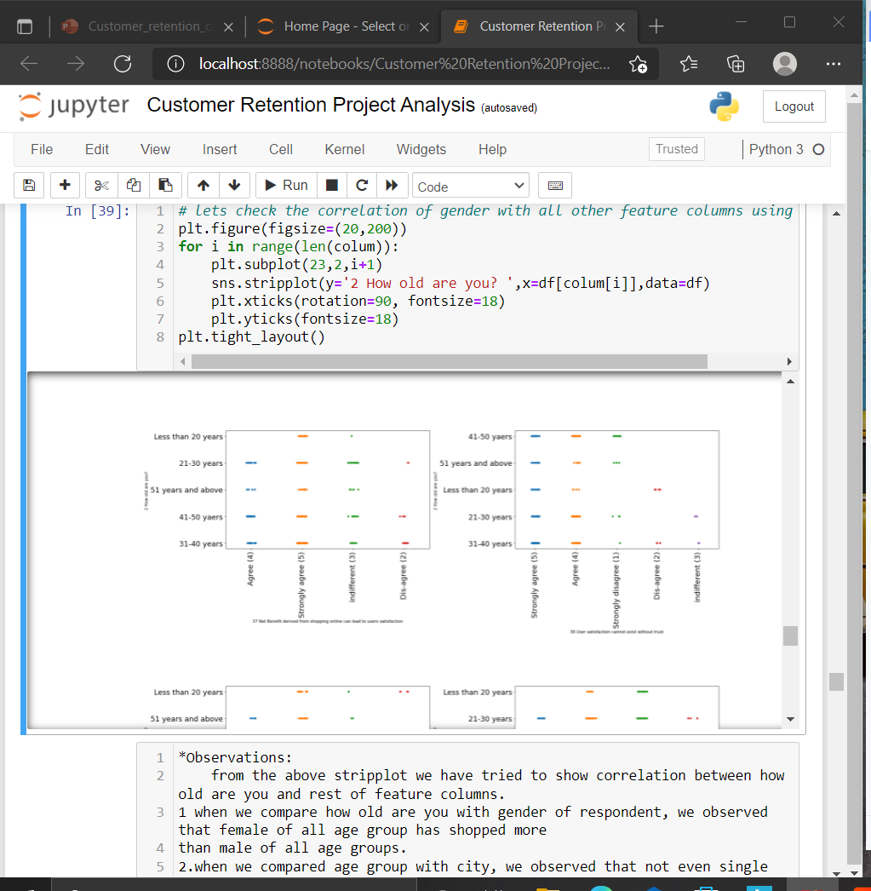
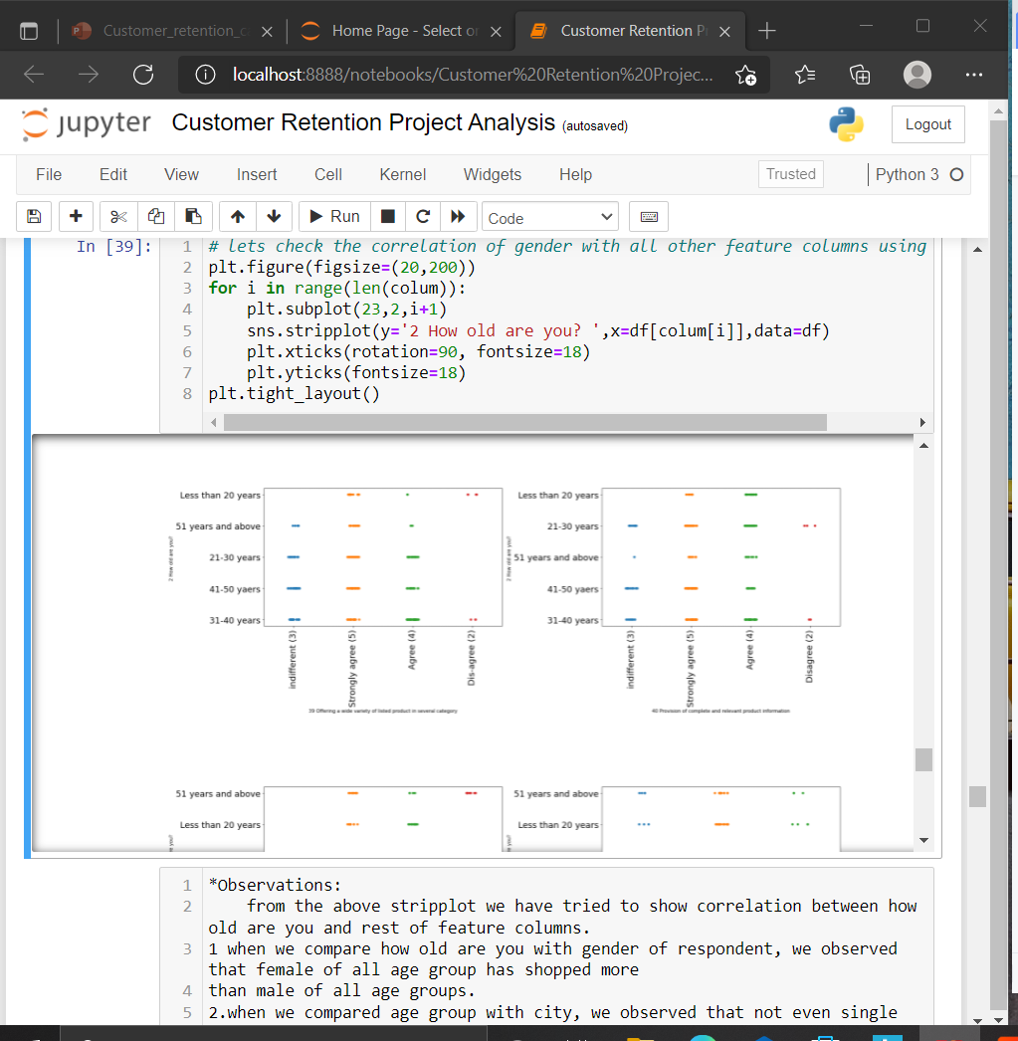




*Observations:
from the above stripplot we have tried to show correlation between how old are you and rest of feature columns.
1 when we compare how old are you with gender of respondent, we observed that female of all age group has shopped more
than male of all age groups.
2.when we compared age group with city, we observed that not even single city have customers from all age group, like in
delhi no single person in the age group 51 years and above shopped online.
3.while comparing with since how lond you are shopping online we observed most people from all age groups are shopping
online since 2-3 years.
4.when we checked for how many times you have made an online purchase in the past 1 year we observed max. people from all
age group answered less than 10 times.
5.while checking mode of internet used while shopping online, we realized that most people used wifi and mobile internet
only some people in the age group of 31-40 used dial-up network.
6.when we check which device customer used to access the online shopping, we observed max. people in all age group used
there Smartphone for online shopping.
7.when we checked the screen size of the mobile device, we observed that most of the people have 5.5inch screen size
followed by others.
8.while checking the os of the device , we observed that almost all kind of os were used by the people like, windows, IOS
and Android. there is not much difference in usage.
9.when we checked the usage of browser, we realized that google chrome is most popular among all the age groups and they
used it for shopping online.
10.which channel did you follow to arrive at your fav. online store first time, we observed most of the people used search
engine to reach there fav. online store for the first time.
11.after 1st visit how do you reach the online retail store, we observed that maximum people used Direct URL to reach to
there fav. online retail store.
12.when we check time customers take before purchase decision, we observed most of the people from all age group takes
more than 15 min.

